Slide 1
Comparative Analysis of Curriculum Learning for Classification Tasks in Deep Learning
The thesis defence
Yue Li
Scientific supervisor: Evalds Urtans

Slide 2
What is Curriculum Learning?(1)
The way how typical training is done:
Difficulty of the sample is indicated by the color with green being the easiest and red being the most difficult.

Slide 3
What is Curriculum Learning?(2)
The way how curriculum learning is done:
Difficulty of the sample is indicated by the color with green being the easiest and red being the most difficult.

Slide 4
Topicality
Curriculum learning has been experimentally proven that it can speed up training and improve model’s performance. Investigate the effectiveness of curriculum learning has great potential impact on the machine learning field.

Slide 5
The goal of the thesis
Type A: Comparative analysis
The goal of this thesis is to investigate the effectiveness of curriculum learning on different classification tasks.

Slide 6
Systematic Literature Review
Widely applicable to various settings and architectures
Paper Title | Deep Learning Subfield | Architecture
Curriculum Learning | Classification task Natural language processing | Plain Neural Network
Worst-Case-Aware Curriculum Learning for Zero and Few Shot Transfer | Main focus of this paper is zero shot, few shot transfer learning | MT-DNN
Curriculum Learning for Recurrent Video Object Segmentation | Video object segmentation | Covn-LSTM
Dynamic Curriculum Learning for Imbalanced Data Classification | Human attribute classification Image classification | CNN
Curriculum Learning by Transfer Learning: Theory and Experiments with Deep Networks | Image classification (classifying one of the super classes of the CIFAR-100's 100 classes: small mamal) | CNN
Curriculum Learning of Visual Attribute Clusters for Multi-Task Classification | Visual attribute classification | CNN
Medical-based Deep Curriculum Learning for Improved Fracture Classification | Image classification | ResNet
Weakly- and Semi-supervised Faster R-CNN with Curriculum Learning | Object detection of 20 different classes | Fast R-CNN
Attention-Guided Curriculum Learning for Weakly Supervised Classification and Localization of Thoracic Diseases on Chest Radiographs | Image classification | ResNet
A Multi-Scale CNN and Curriculum Learning Strategy for Mammogram Classication | image classification | ResNet
10 papers reviewed.
5 Different tasks.
6 different architectures.

Slide 7
Experiments
Experiments:
Four controlled experiments are designed to evaluate the effectiveness of two naïve (manually designed) curriculums.
The control group (non-curriculum group) : training without using curriculum.
The experimental group (curriculum group): training using curriculum.
Metrics: Training loss, training accuracy, validation accuracy, test accuracy, etc.
For statistical significance: 10 repeats for each experiment.
Experiment | Dataset | curriculum
MNIST experiment | MINIST | Noise curriculum
KMNIST experiment | KMINST | Noise curriculum
CIFAR10 experiment | CIFAR10 | Noise curriculum
KEMNIST experiment | EMNIST-letter + KMNIST | Class curriculum

Slide 8
Noise Curriculum

Slide 9
Noise Curriculum Experiments
Dataset | MNIST | KMNIST | CIFAR10
Training | 50000 | 50000 | 40000
Validation | 10000 | 10000 | 10000
Test | 10000 | 10000 | 10000

Slide 10
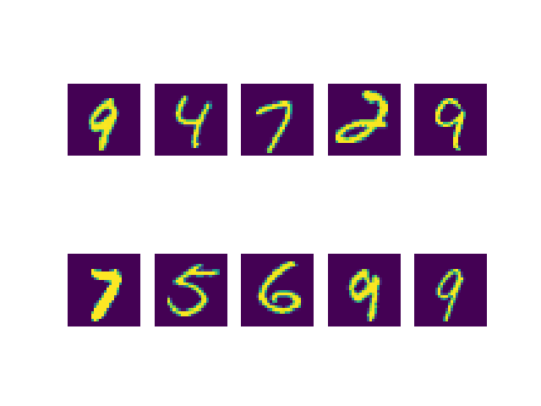
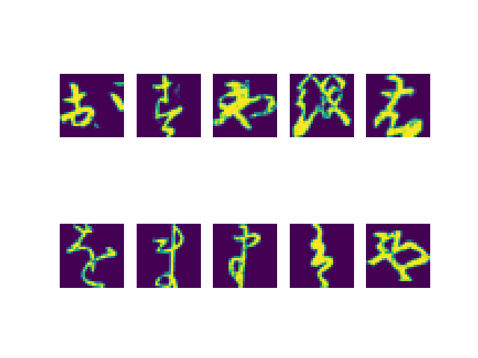
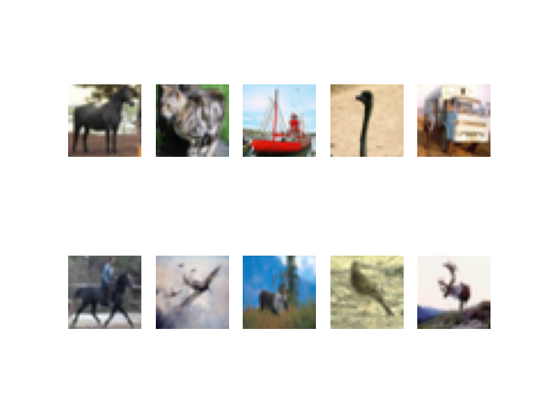
Datasets- Noise Curriculum
MNIST
KMNIST
CIFAR10

Slide 11
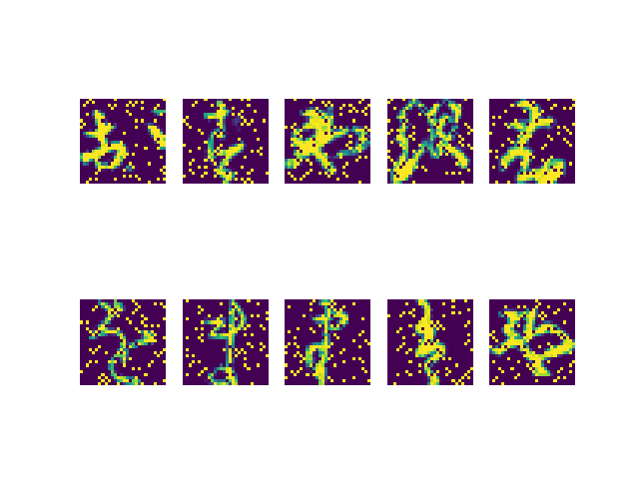
Samples with 20% Noise
MNIST
KMNIST
CIFAR10

Slide 12
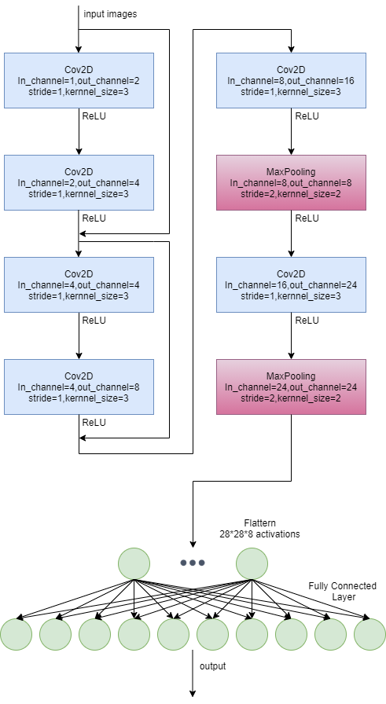
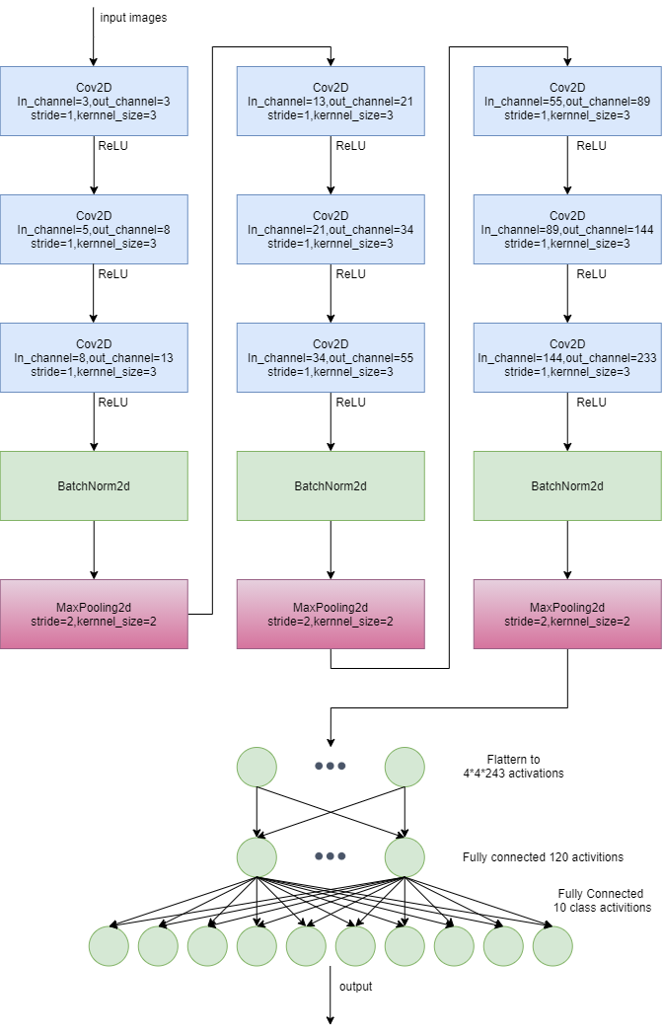
Architectures
MNIST
KMNIST
CIFAR10

Slide 13
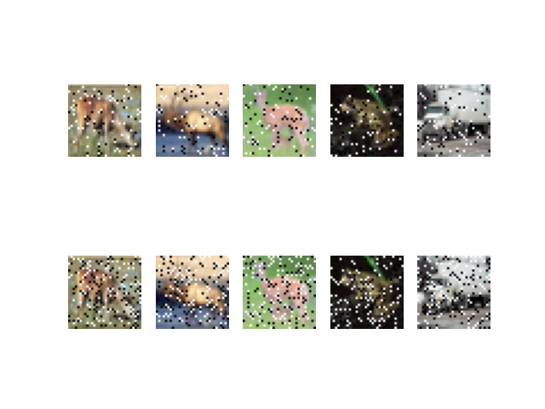
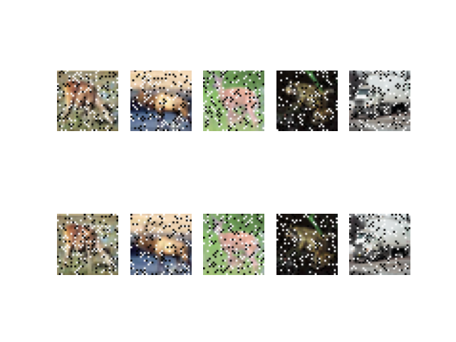
Noise Curriculum in Picture
Epoch 0
Epoch 9
Epoch 19
Top row: curriculum group; bottom row: non-curriculum group
Control group noise: 20% fixed

Slide 14
Class Curriculum
Definition:
Using a clean dataset and starting from 1, the class curriculum increases the number of external classes in the clean dataset by 1 at each step during training until maximum number of external classes in the original mixture dataset is reached.

Slide 15
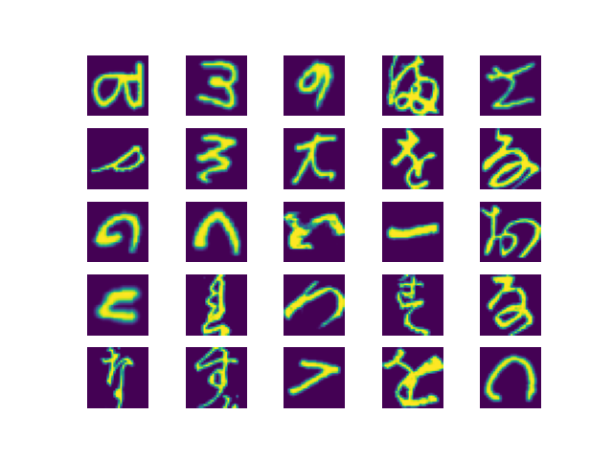
KEMNIST Dataset
EMNIST
KMNIST

Slide 16
KEMNIST Experiment
Two sub-experiments with respectively maximum 5 and 10 KMNIST classes allowed.
Dataset configuration:
Training set:100000 samples.
Validation set:10000 samples.
Test set: 10000 samples
10 repeats for each sub experiment with 100 epochs for each repeat.

Slide 17
Architecture

Slide 18
Class Curriculum in Picture

Slide 19
Statistical Analysis

Slide 20
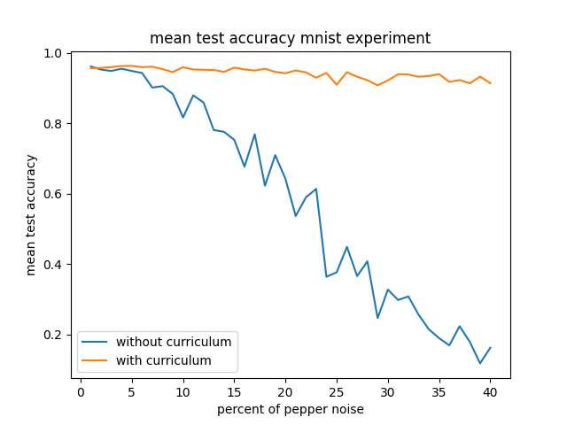
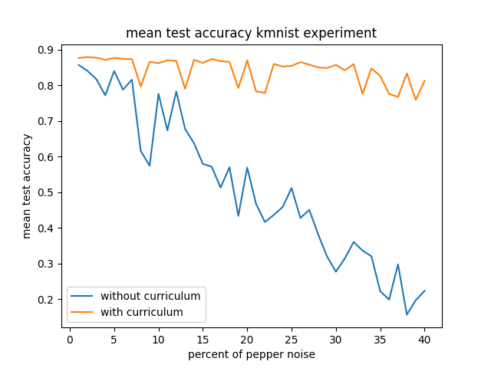
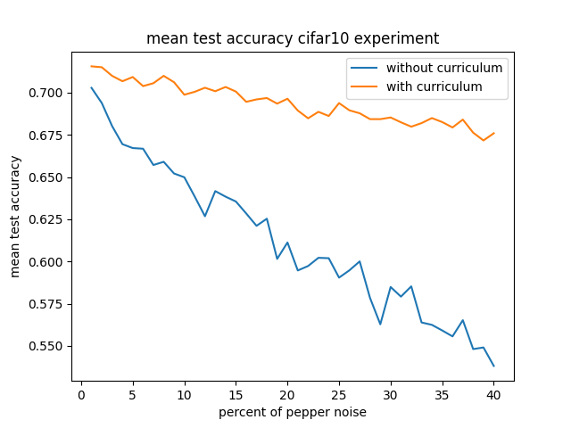
Results – Noise Curriculum
Noise Curriculum – test accuracy
MNIST
KMNIST
CIFAR10

Slide 21
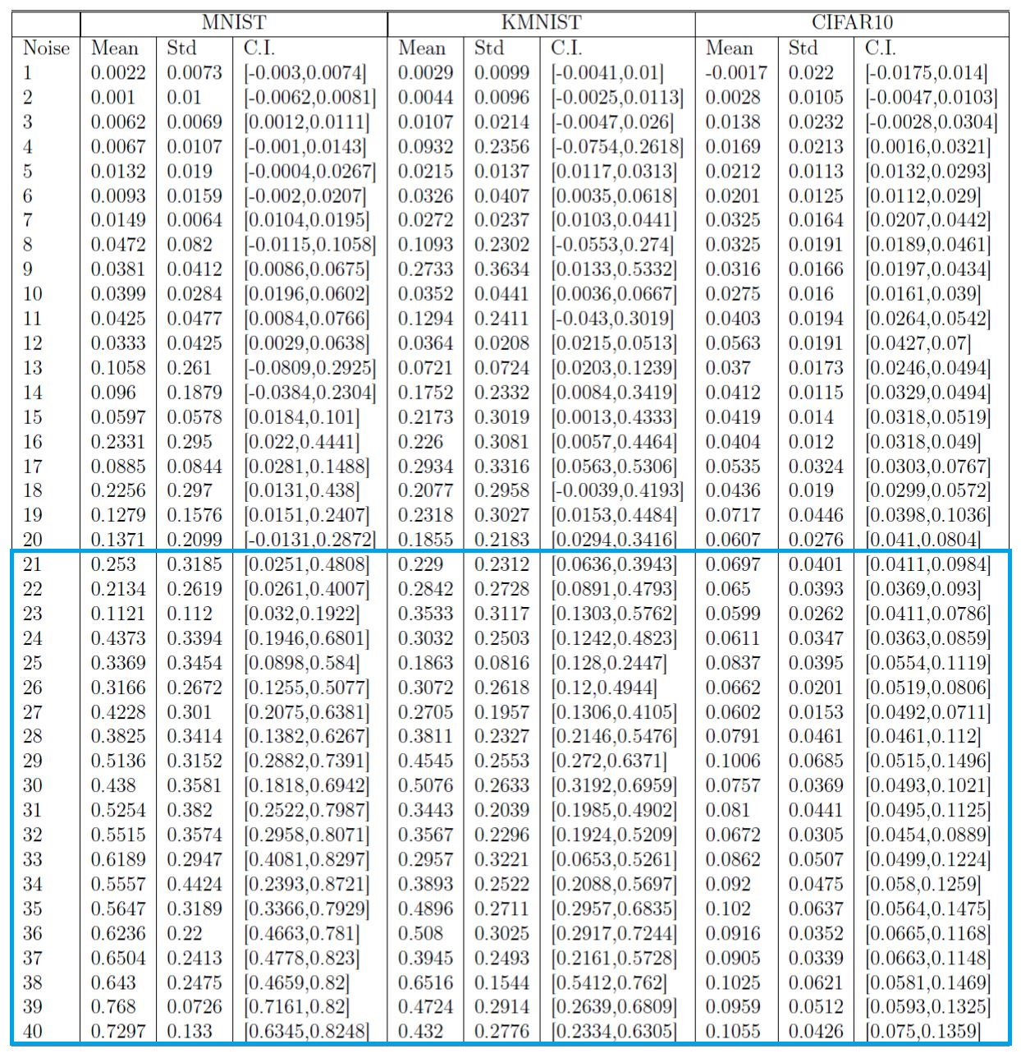
Noise Curriculum
Effectiveness

Slide 22
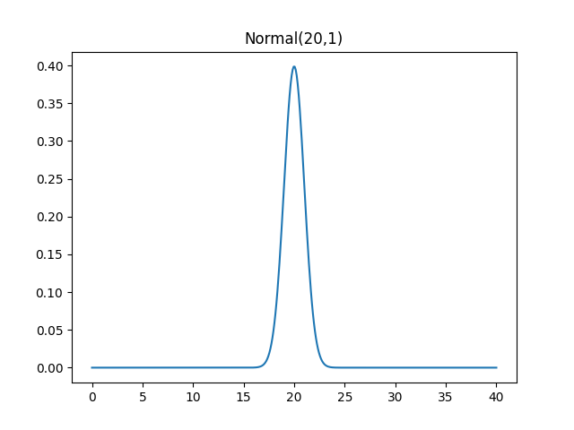
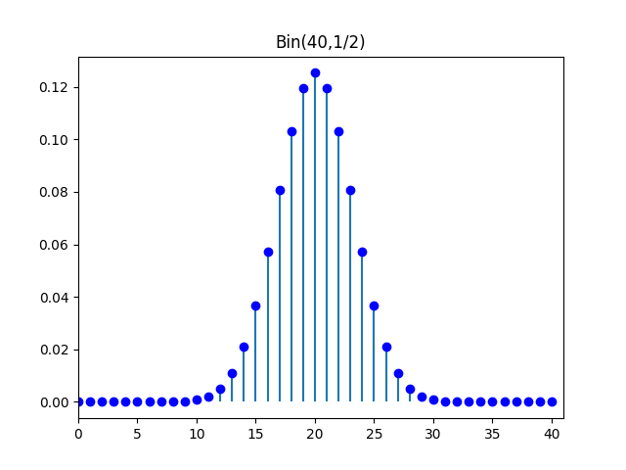
Binomial Approximation
Large number of pixels in a image.
Treat percentage of noise as continuous is reasonable.
Approximated by
$$E\left(D\right)=\sum_{i=1}^{40}{p\left(X=i\right)D(x)}$$

Slide 23
Aggregation – Noise Curriculum
Experiment | Mean | Standard deviation | Confidence Interval (95%)
MNIST | 0.3297 | 0.1124 | [0.2492,0.4101]
KMNIST | 0.3366 | 0.0564 | [0.2962,0.377]
CIFAR10 | 0.0836 | 0.0108 | [0.0759,0.0913]
With approximately 95% confidence.

Slide 24
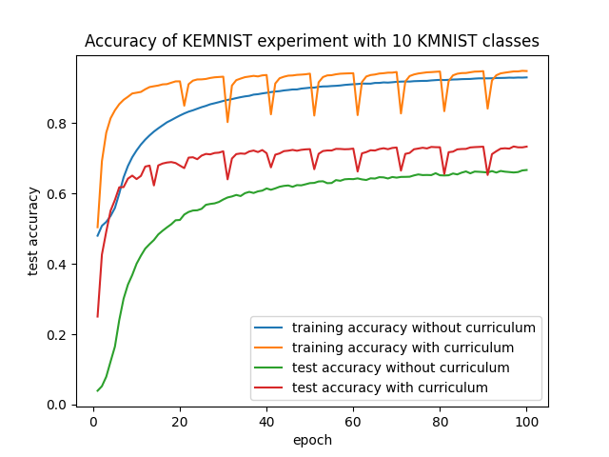
Results - Class Curriculum

Slide 25
Aggregation – Class Curriculum
Max KMNIST Classes | Mean | Standard Deviation | Confidence Interval (95%)
5 | 0.0525 | 0.0428 | [0.015,0.0901]
10 | 0.1217 | 0.0869 | [0.0347,0.2088]
With exactly 95% confidence.

Slide 26
Conclusions
Curriculum learning is in essence the process of deciding the ordering of the samples to be fed into a model based on difficulty. Such decision sometimes can be made based on the difficulty of the samples perceived by human.
Well designed curriculum can reduce loss, increase training accuracy, validation accuracy and test accuracy when compared to not using one.
Manually design and tune curriculum require insights and lots of efforts.
Pending for publication

Slide 27
Thank you for attention!

