Slide 1
Dr. Evalds Urtans
SIA ASYA

Slide 2
Comunity of AI researchers "DataScience Latvia"

Slide 3
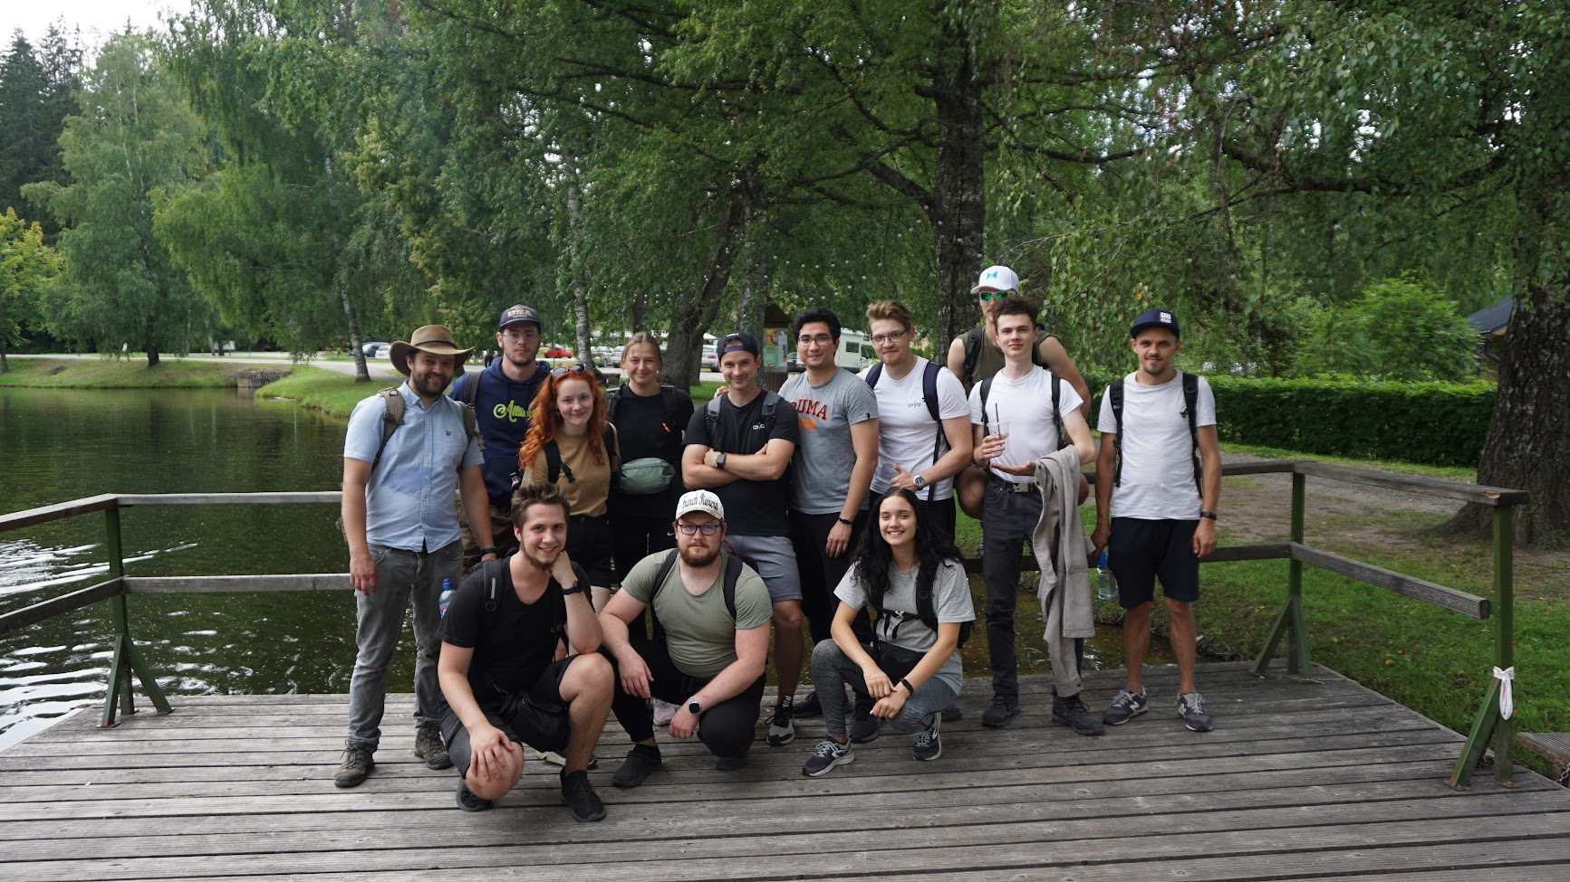
Team
Experienced sales team
Award-winning UX designers
Award-winning AI scientists

Slide 4
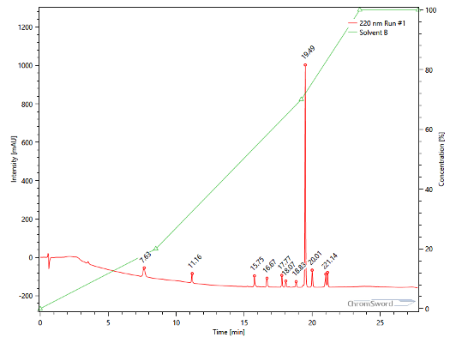
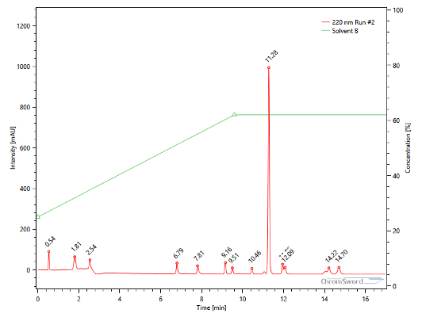
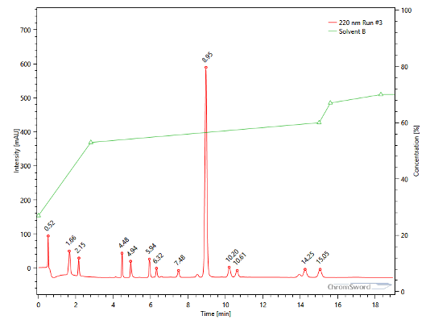
PROJECT #1 SOLVENT GRADIENT OPTIMIZATION
AI models for finding solvent gradient to separate compounds
in chromatography for analytical chemistry and mass
spectrometry.
Automatically executes experiments to reduce human
resources form 2 weeks to 2 hours and achieve high quality
separation for unknown substances.
Partner: www.chromsword.com

Slide 5
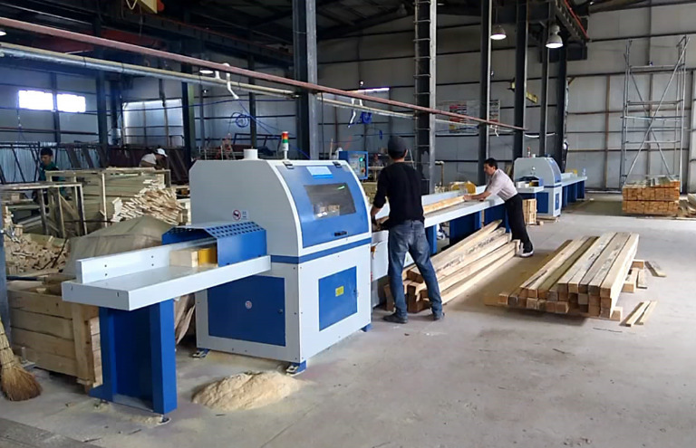
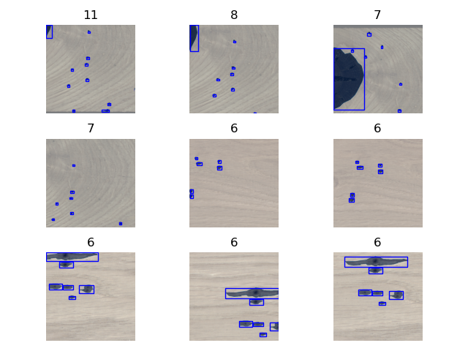
PROJECT #2 DETECTION OF DEFECTS IN WOODEN PLANKS
Successful project in cola with medium size company to get high precision AI models for detecting defects in wooden planks
to automatically plan cutting and manufacturing processes.
70-99% precision to various classes of damage
Partner: http://www.zippyvision.com
Our original work, published BDAI 2022

Slide 6
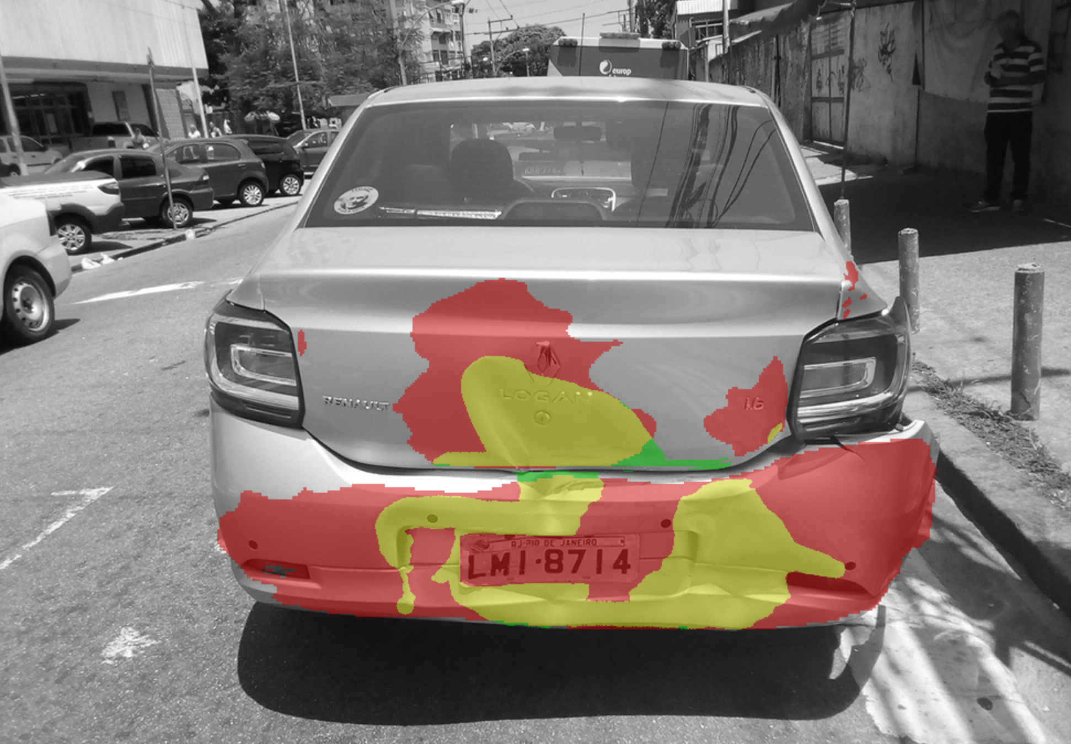
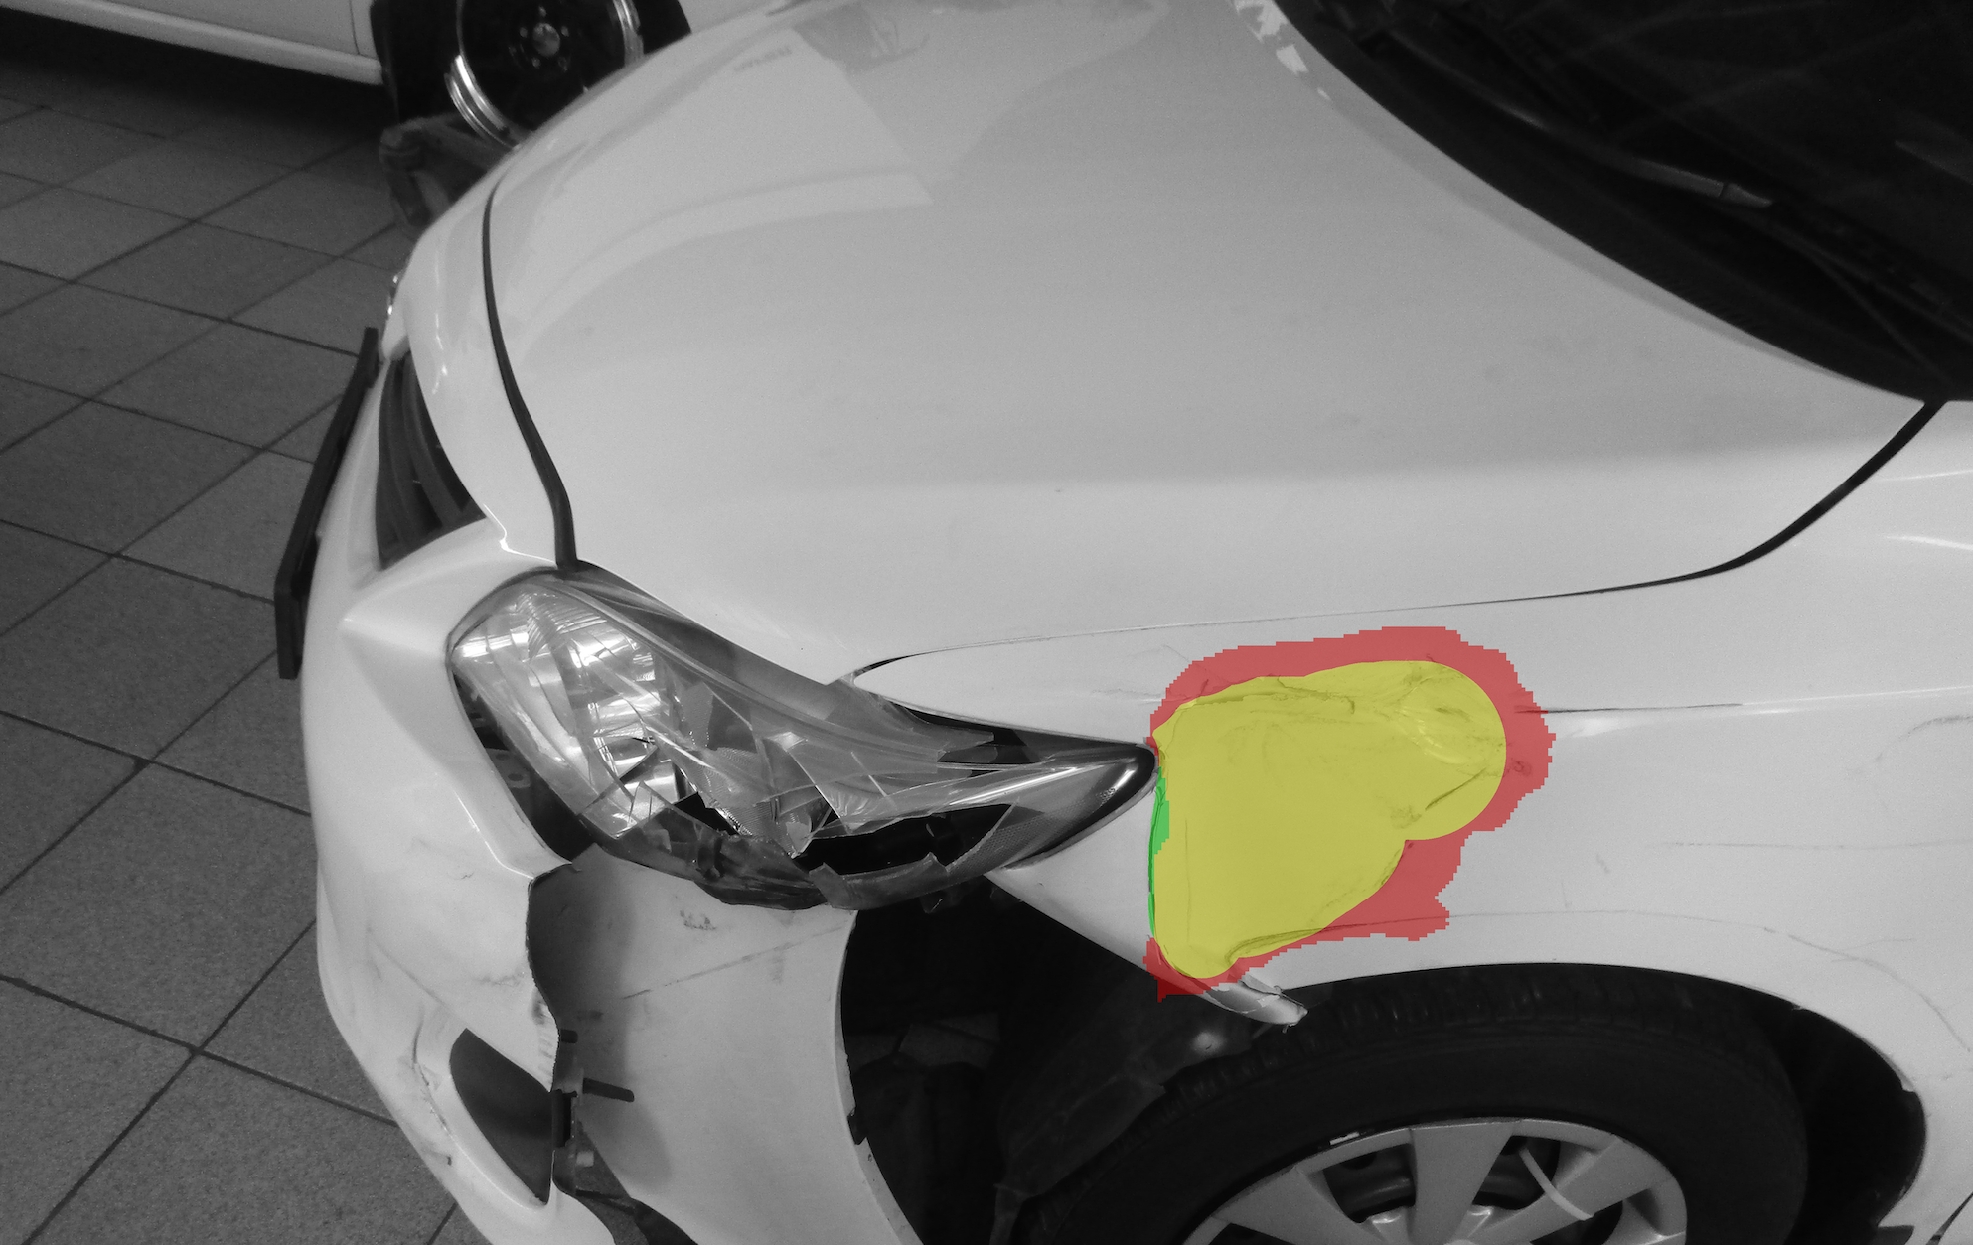
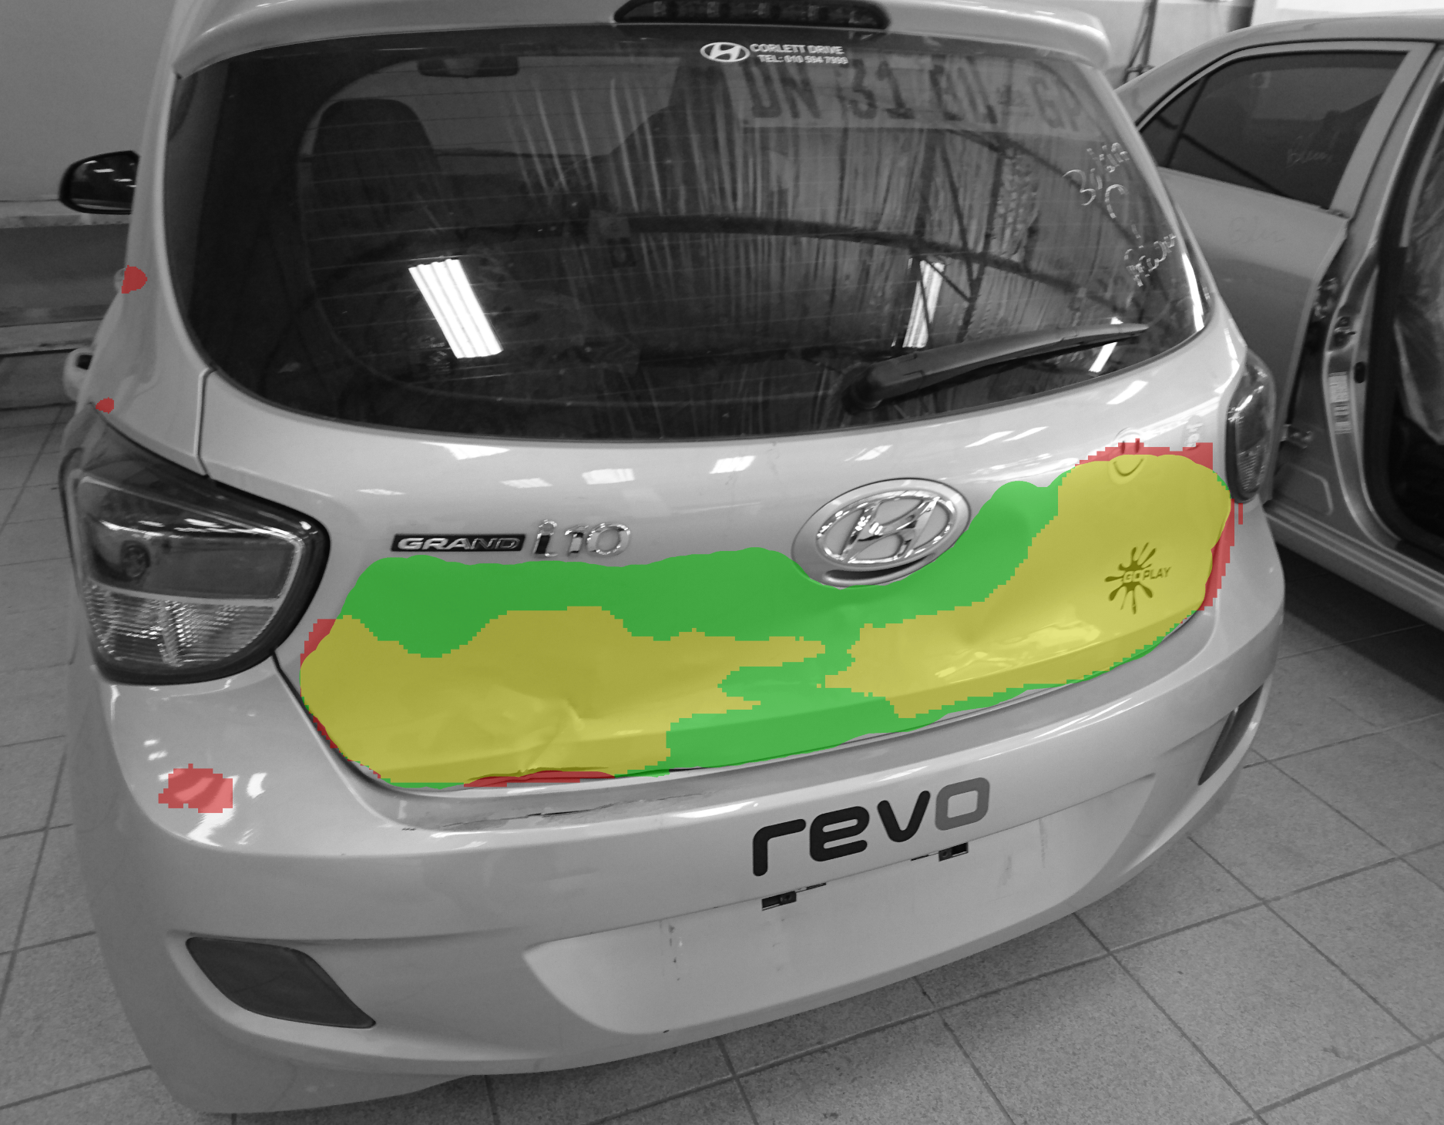
PROJECT #3
DETECTION OF DAMAGE FOR CARS
Successful project to segment different
types of defects in cars using mobile phone after returning them to the rent and before re-selling.
Partner: www.scopetechnology.com

Slide 7
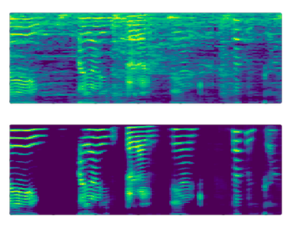
PROJECT #4 AUDIO AND VIDEO DENOISING
Successful project with one of the largest microphone manufacturers in the region to denoise audio signal in real time using deep learning models.
Models can remove noises like:
Sounds of speaker's feedback
Keyboard clicking
Traffic
Sounds of children in background
Other mechanical noises
Before (noisy audio)
After (clean audio)
LIAA Innovation Vaucher

Slide 8
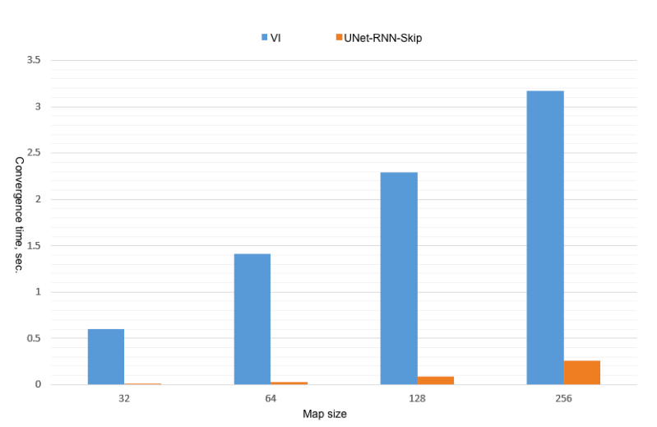
PROJECT #5 COVERAGE AND POLICY PLANNING FOR INDUSTRIAL CLEANING ROBOTS
Consulting companies and publishing original scientific papers on Deep Learning based policy models for cleaning robots.
Models can autonomously explore environment and do value based policy planning 10x faster than classical, non-deep learning algorithms.
Our original work, published ICoIAS 2020

Slide 9
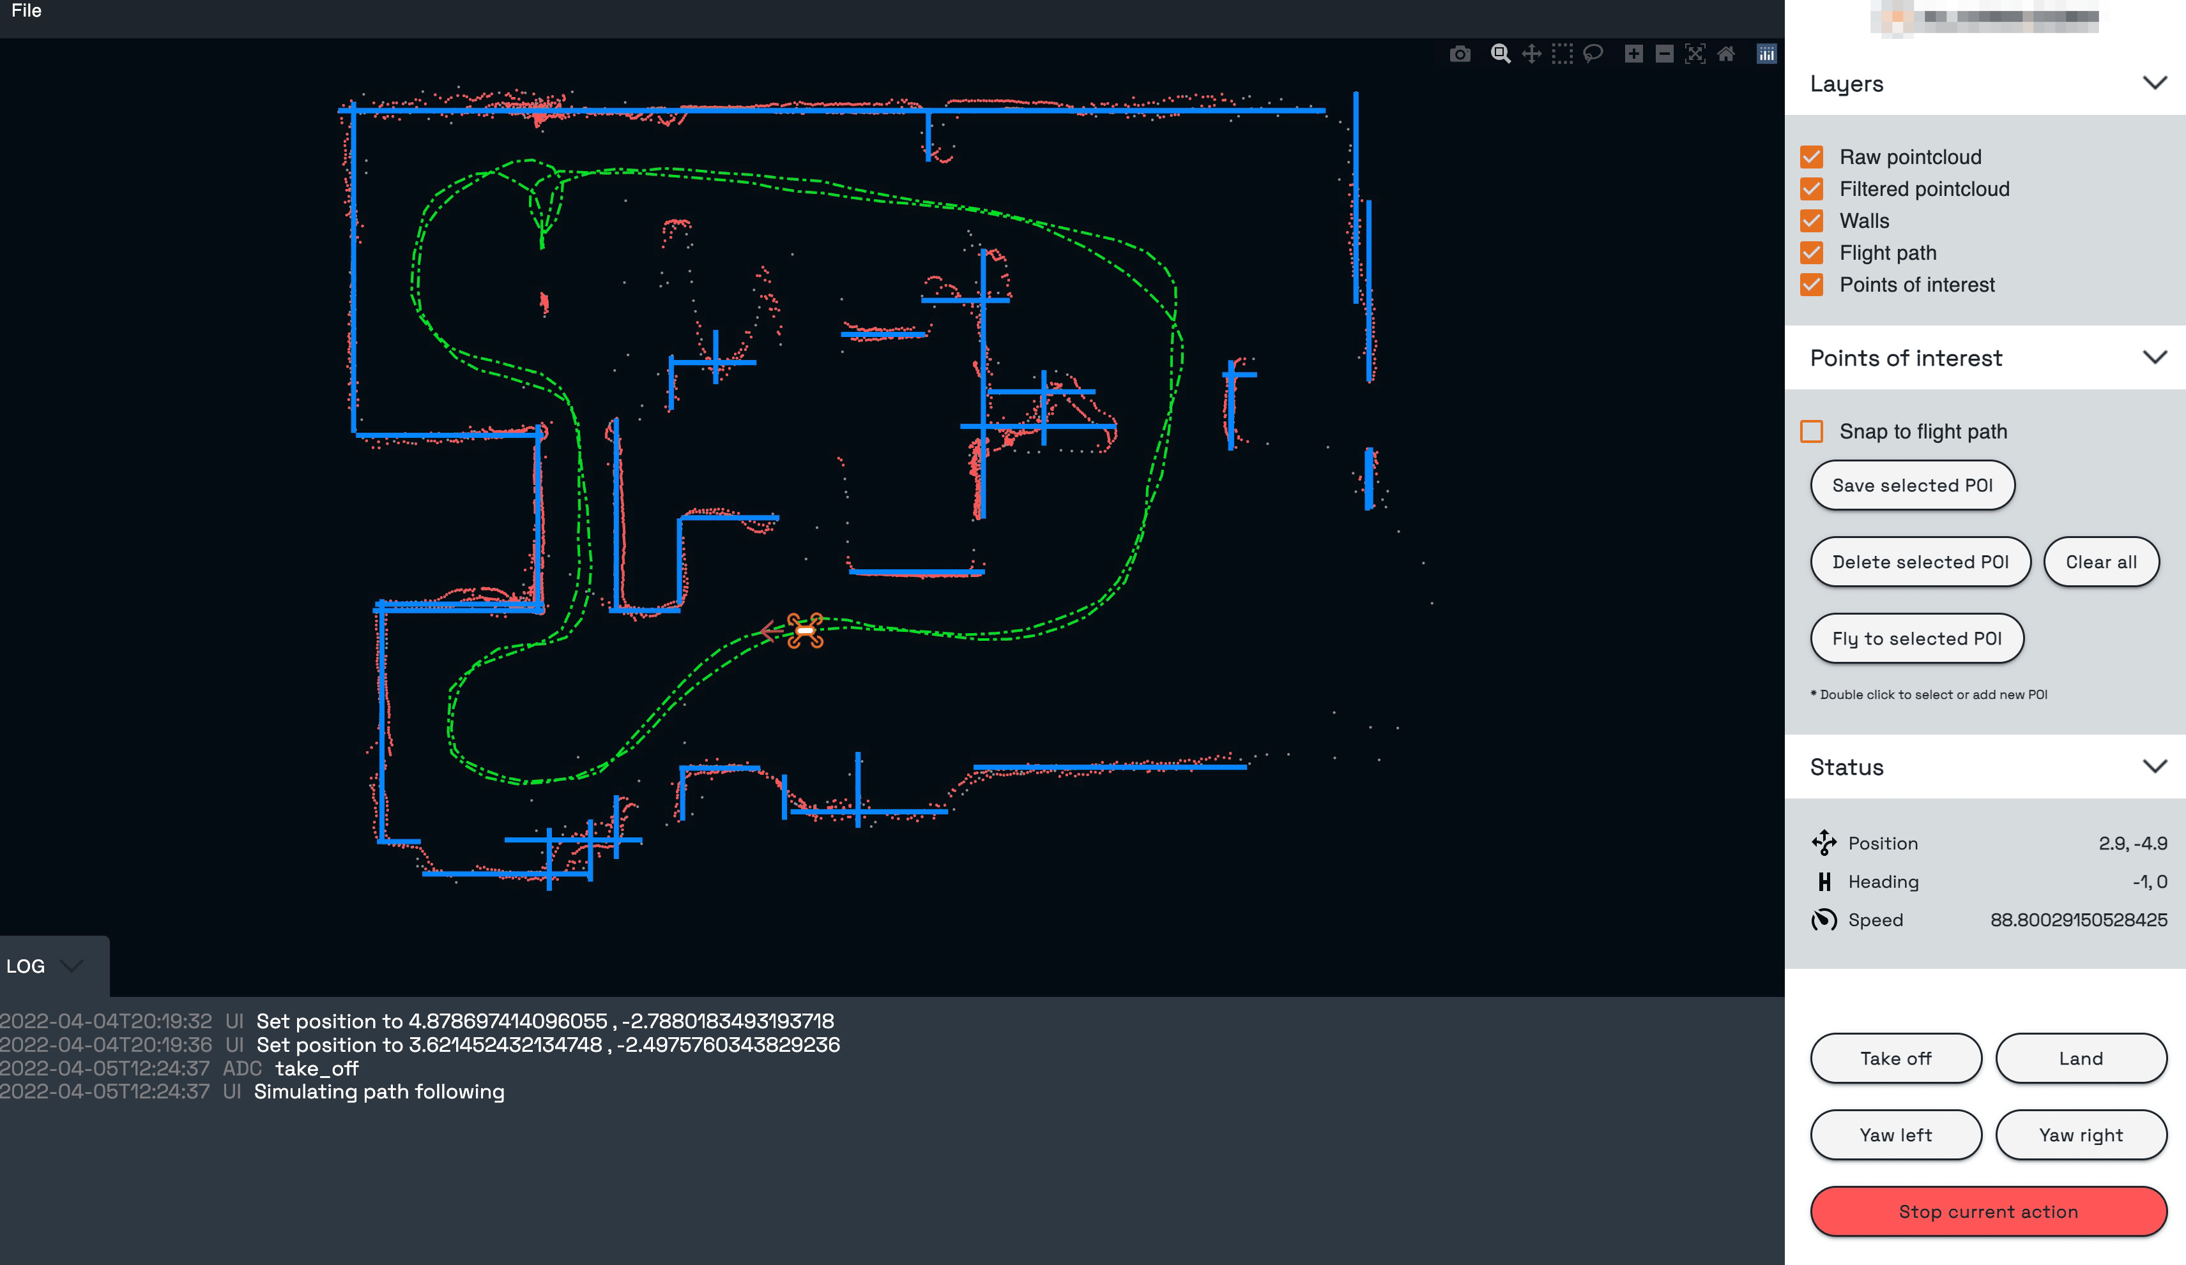
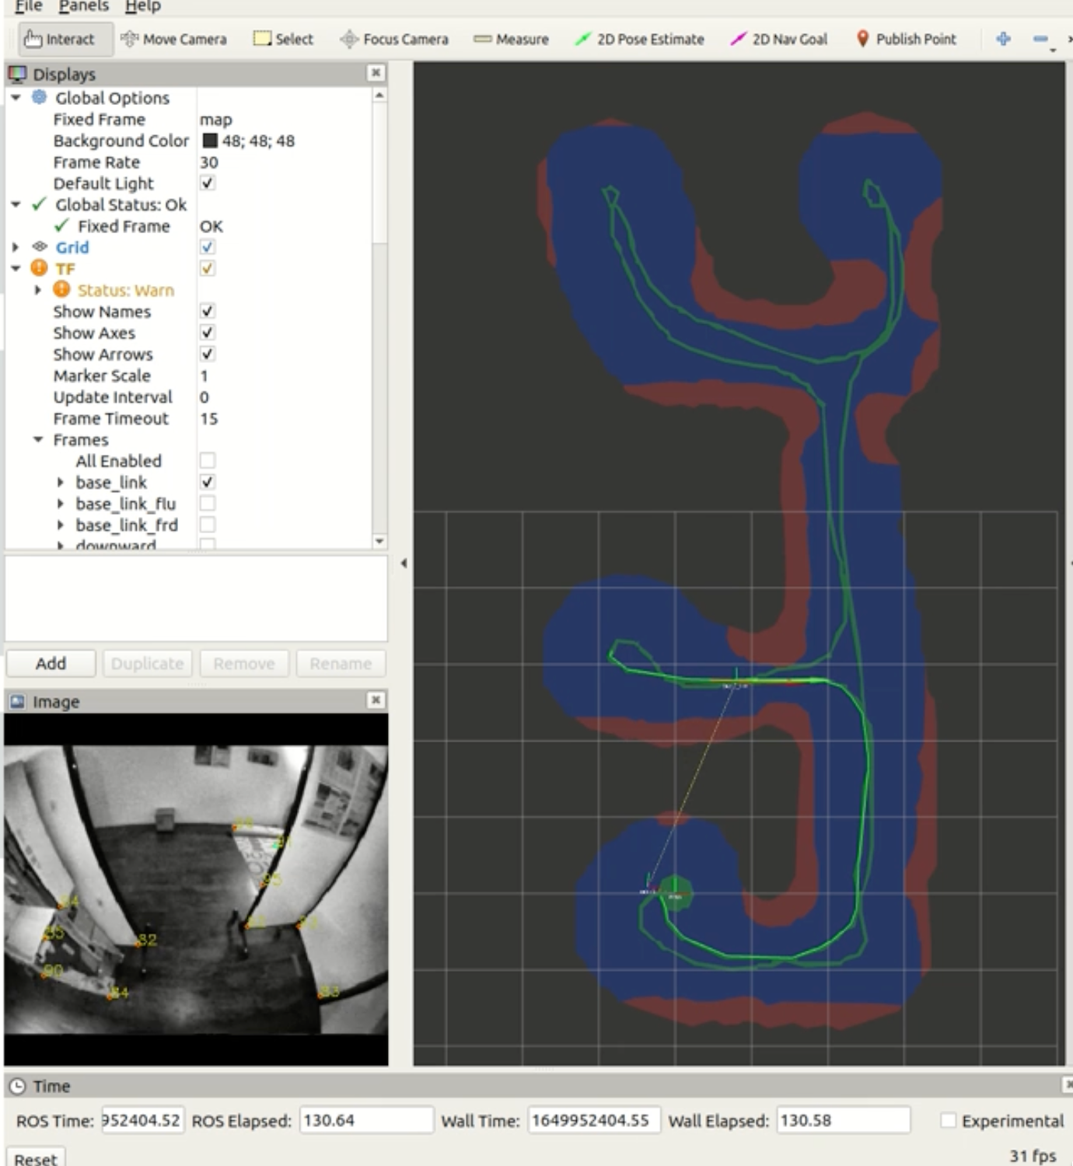
PROJECT #6 POINT-CLOUD IN-FILLING MODELS WALL DETECTION, FLIGHT CONTROL
Security drones project,
LIDAR point-cloud cleanup and enhancement using Deep Learning models
Partner: NDA USA-based

Slide 10
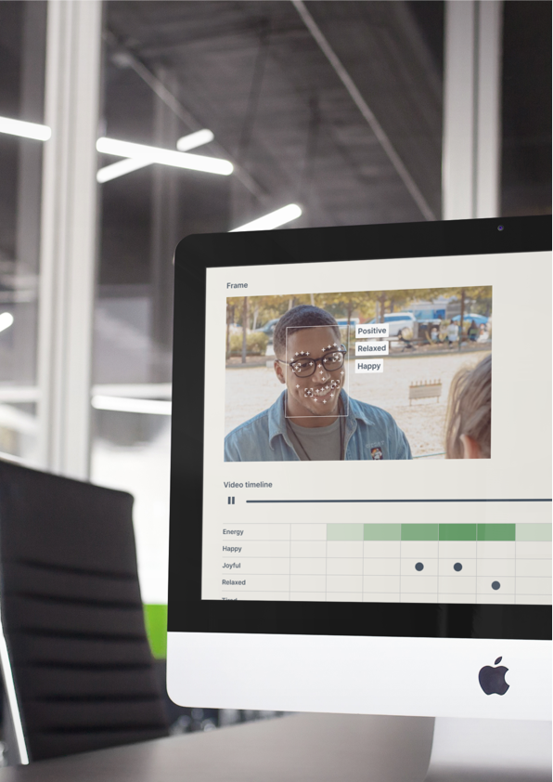
PROJECT #7, PITCHPATTERNS.COM VIDEO UN AUDIO ANALYTICS OF CALLS
AI-based automatic call analysis tool to improve sales & customer service.
Functions:
What emotions does employee use to answer calls?
What is the stress level of employee?
What is the emotional state of an employee?
How much employee listens to a customer?
Verification (VoiceID, FaceID)

Slide 11
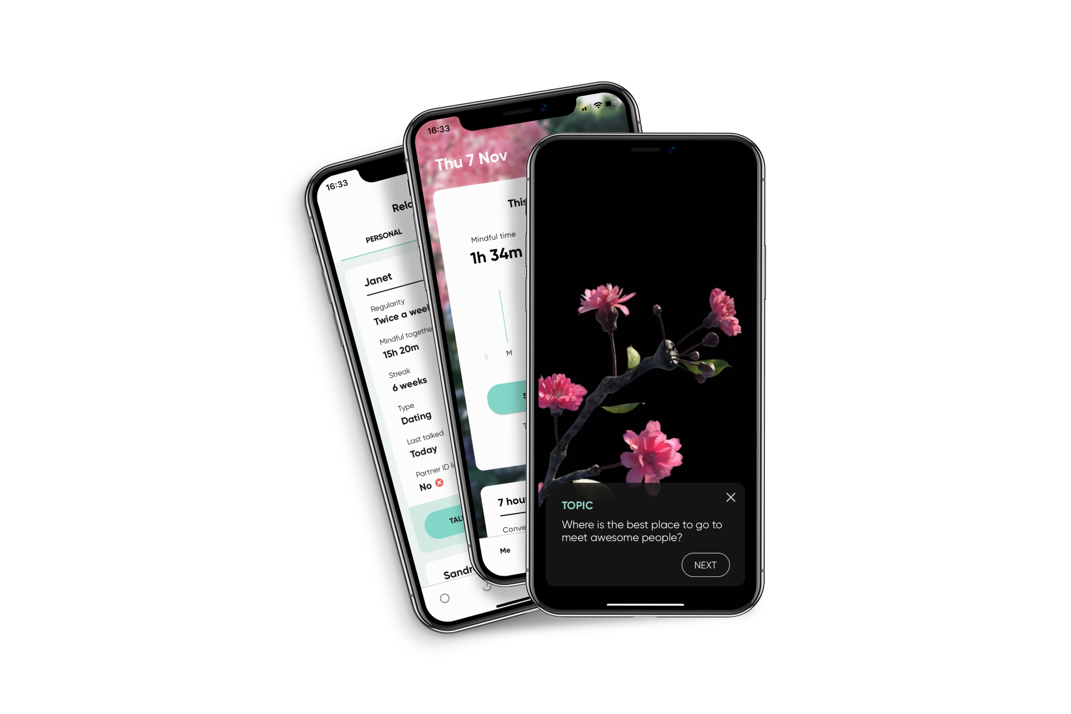
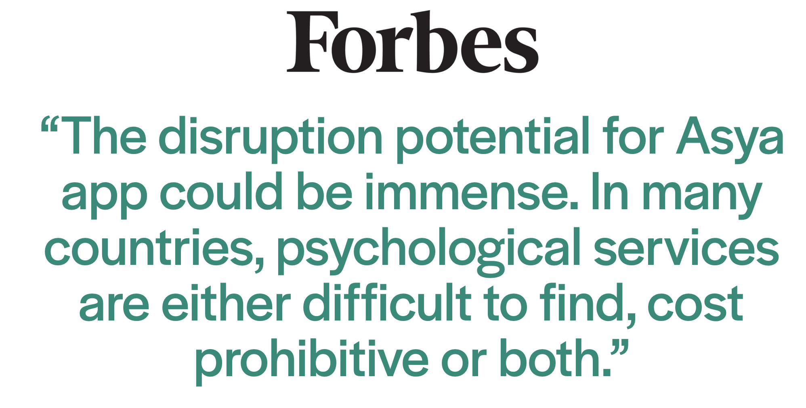
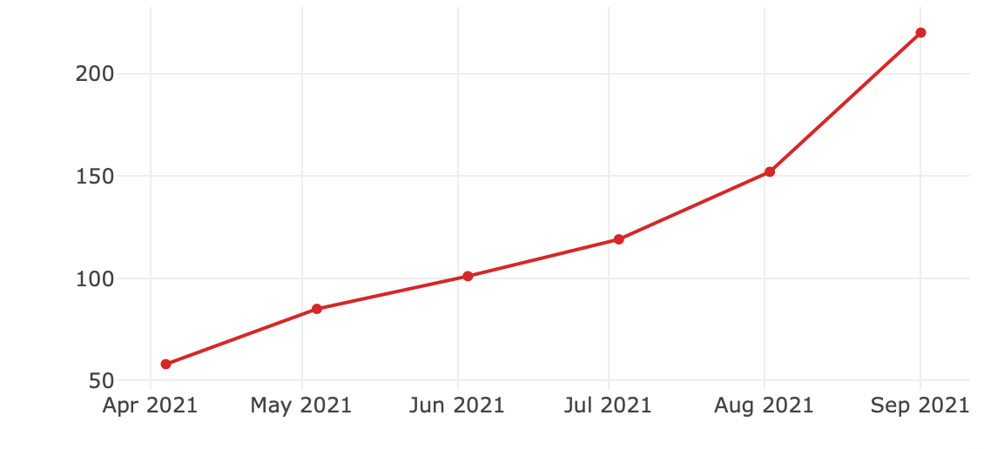
PROJECT #8, CLOSER TO YOU (ASYA), B2C APP AI THAT RECOGNIZES EMOTIONS IN VOICE
AND GIVES CONVERSATION TOPICS
50k users, 300+ paying, 20% MoM

