Slide 1
FaRADAI
Frugal and Robust AI for Defence Advanced Intelligence
WP3: T3.3. Dataset creation with minimal labelling resources
Telegram War Dataset
Evalds Urtans

Slide 2
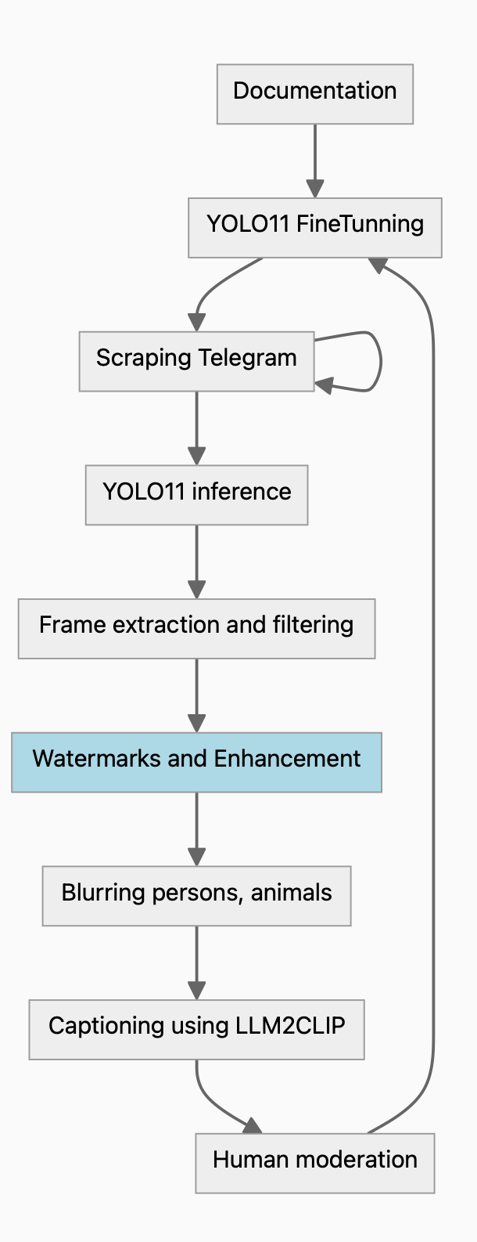
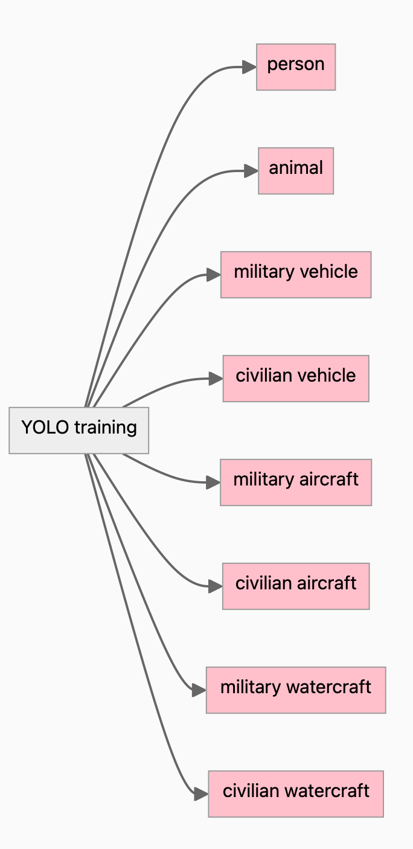
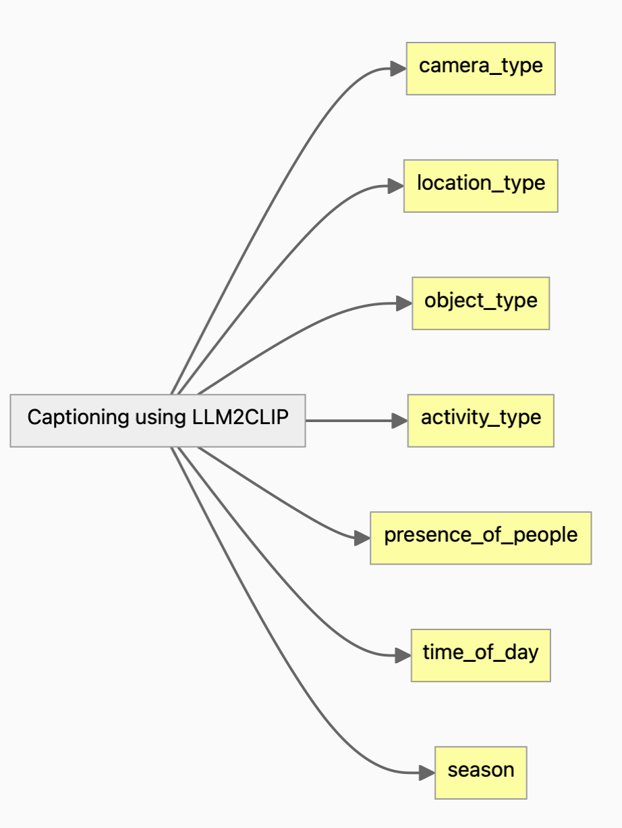
Telegram War Dataset
Methodology
Instance segmentation Image captioning
87464, 1.7TB
mAP50 = 0.79
18091, 132GB

Slide 3
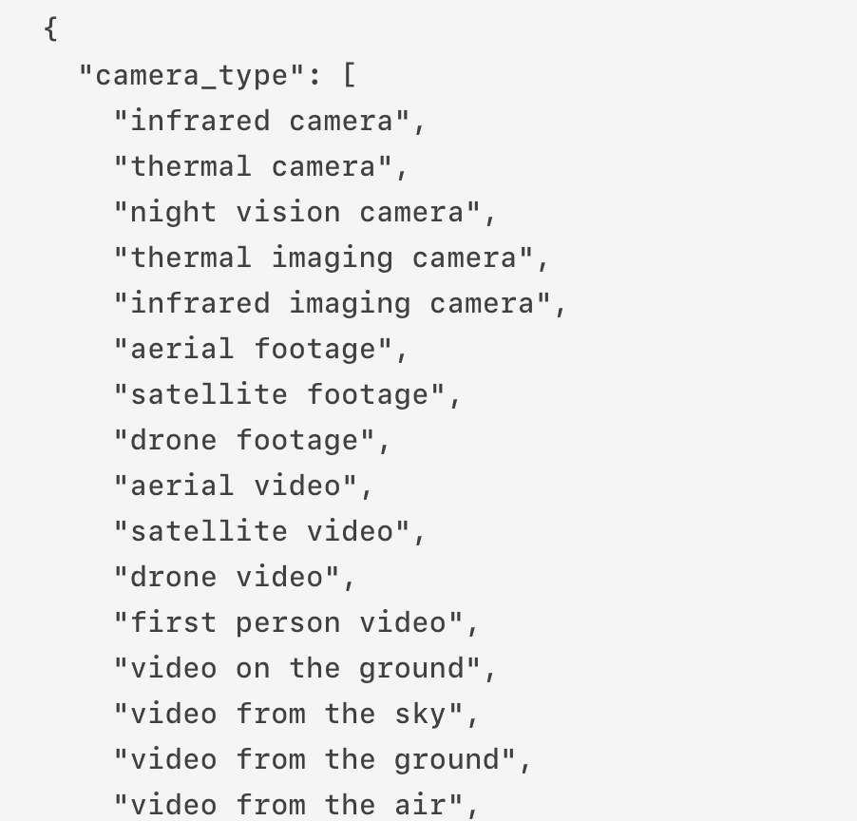
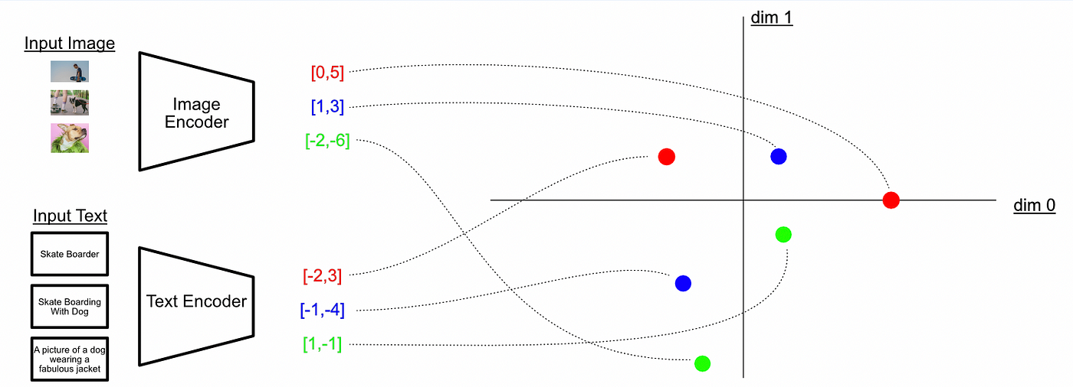
Telegram War Dataset
Methodology – ✅ LLM2CLIP
❌ SAM, BLIP2, LLAMA3.2 Vision, GPT 4o

Slide 4
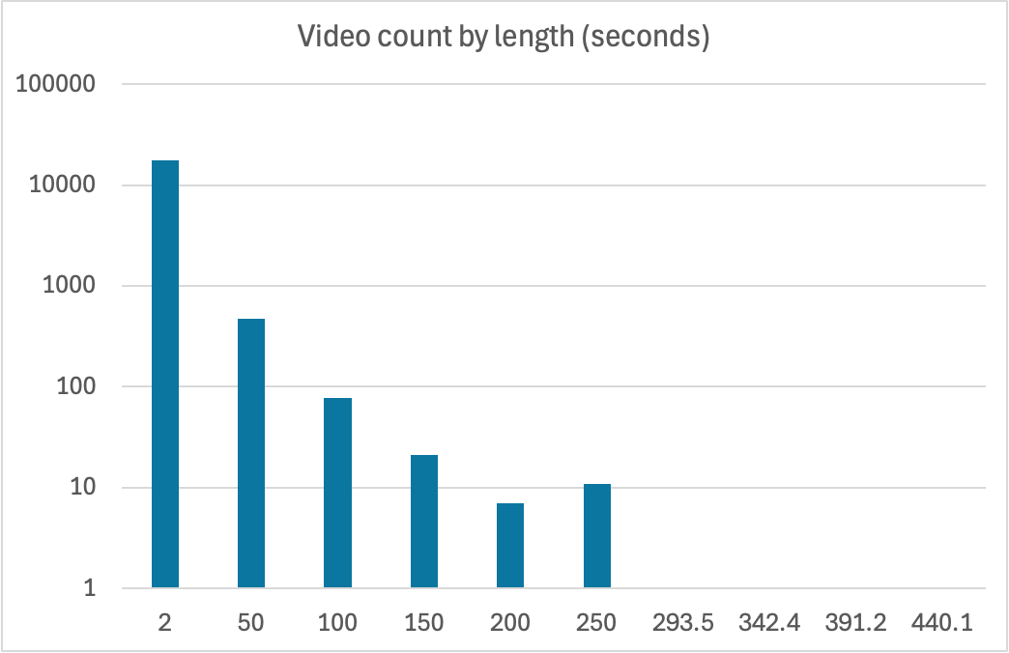
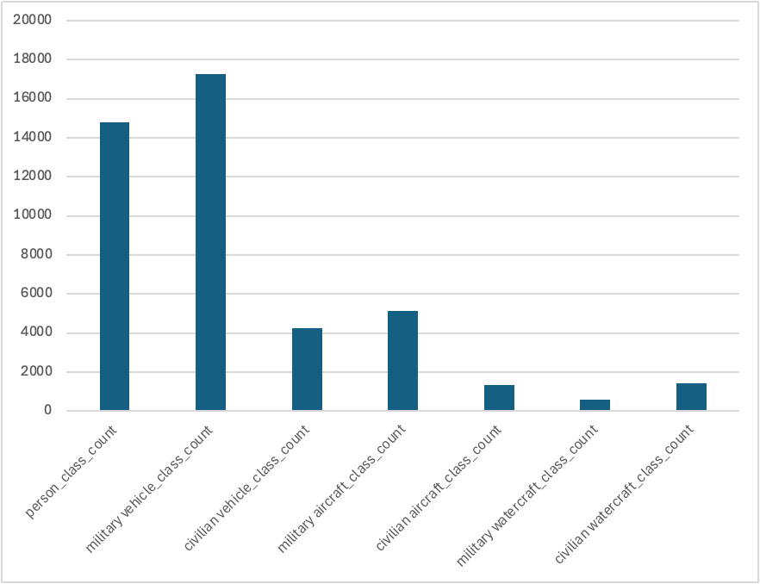
Telegram War Dataset
Statistics so far 18091 videos, 1279.46 hours, 132GB, 25FPS, RGB, Infrared

Slide 5
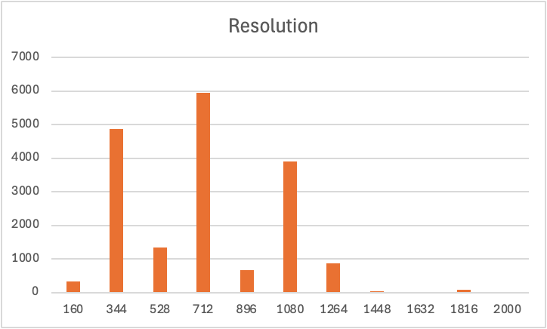
Telegram War Dataset
Statistics so far 18091 videos, 1279.46 hours, 132GB, 25FPS, RGB, Infrared

Slide 6
Telegram War Dataset
Military watercraft

Slide 7
Telegram War Dataset
Military aircraft

Slide 8
Telegram War Dataset
Military vehicle

Slide 9
Telegram War Dataset
Military vehicle

Slide 10
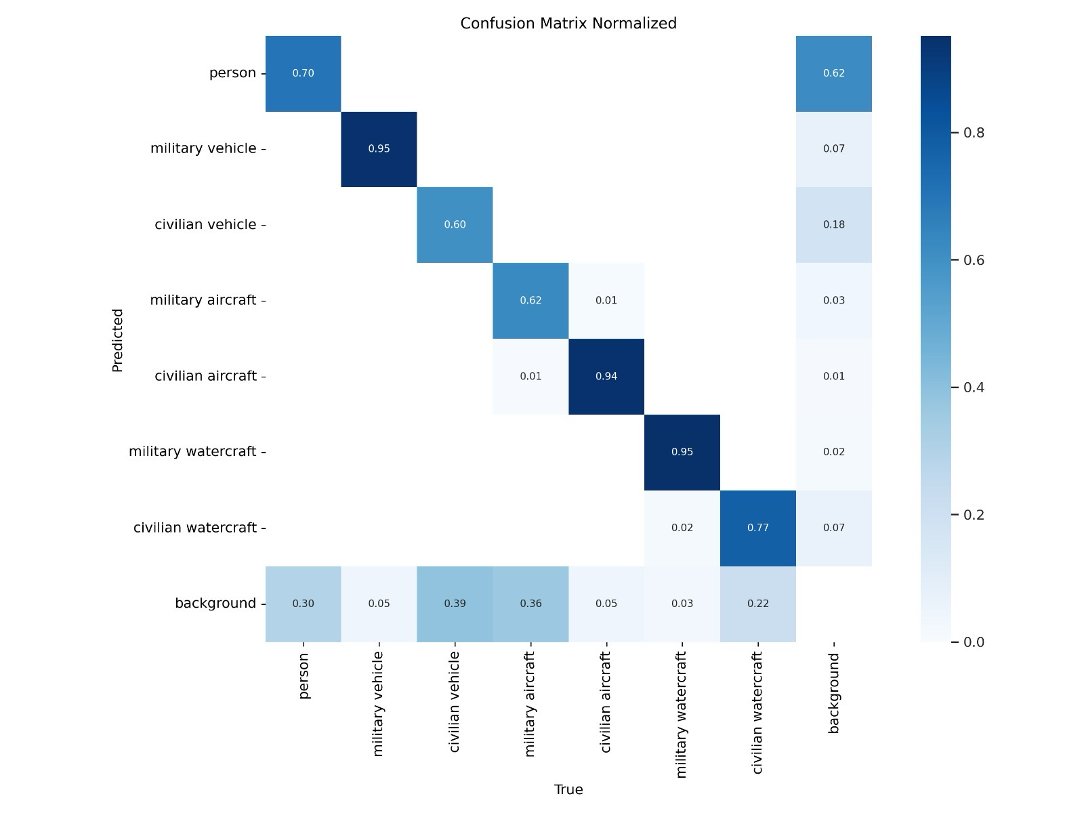
Telegram War Dataset

Slide 11
Telegram War Dataset
Military vehicle

Slide 12
Telegram War Dataset
Infrared

