Slide 1
LLM Prompt Engineering basics
Asoc. Prof. Evalds Urtans

Slide 2
Time series - RNN, LSTM

Slide 3
Time series - Autoregressive
production / inference

Slide 4
Time series

Slide 5
Time series, Language modelling, Tokens

Slide 6
Time series

Slide 8
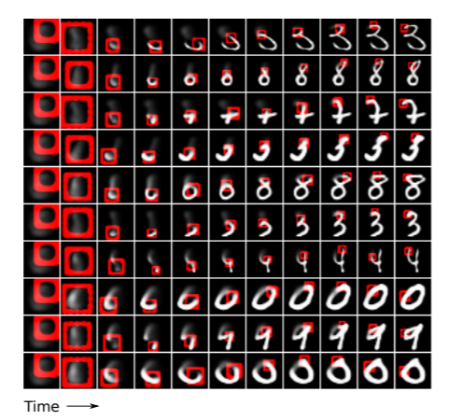
Attention mechanism

Slide 9
Attention mechanism

Slide 10
Attention mechanism

Slide 12
Attention mechanism

Slide 13
Attention mechanism
BERT (Google), GPT (OpenAI), 2018
Limited contect window ~3380 tokens** (or tradeoffs,200k)
GPU 40GB
Training datasets:
Common Crawl, Wikipedia,
Reddit comments, utt.

Slide 14
Use-cases
1. ChatGPT
2. ChatGPT + Sources
3. RAG systems

Slide 15
1. ChatGPT alone
Jautājums Latvijas vēsturē: "Apraksti agrāro reformu tās ieguvumus un negatīvās sekas? Vai šadu reformu varētu veikt mūsdienās, kāpēc?"
Notes:
Jautājums Latvijas vēstures eksāmenā: "Apraksti agrāro reformu tā ieguvumus un negatīvās sekas? Vai šadu reformu varētu veikt mūsdienās, kāpēc?"
Write the Answer in "1 paragraph" using "Factual References with Numbers":

Slide 16
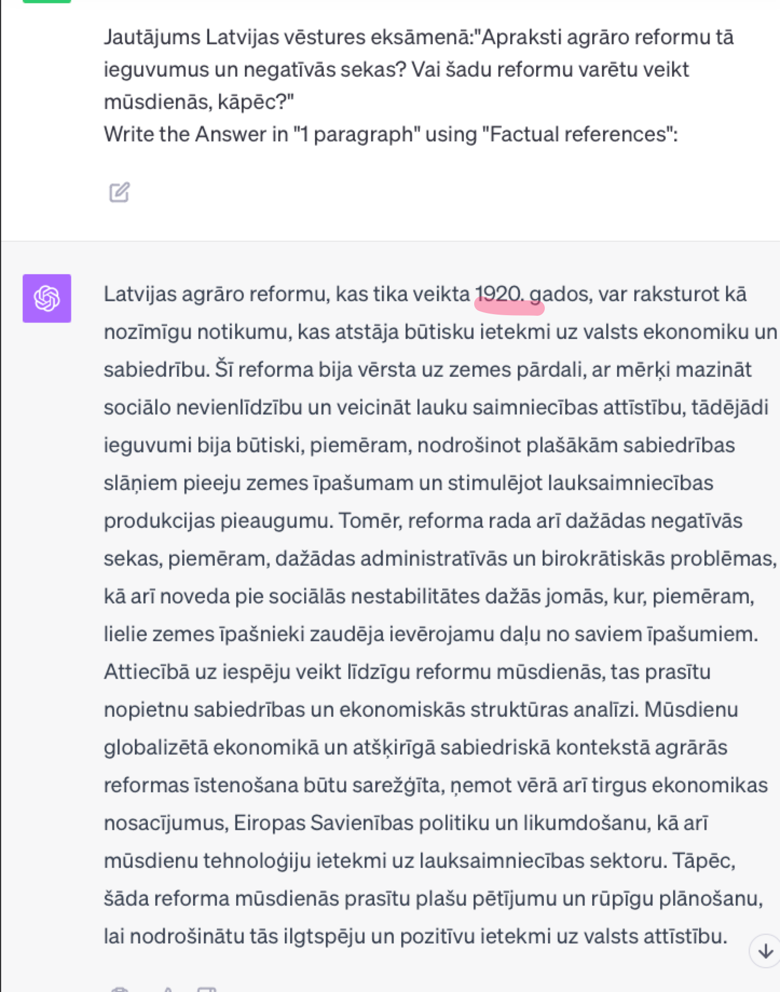
1. ChatGPT alone

Slide 17
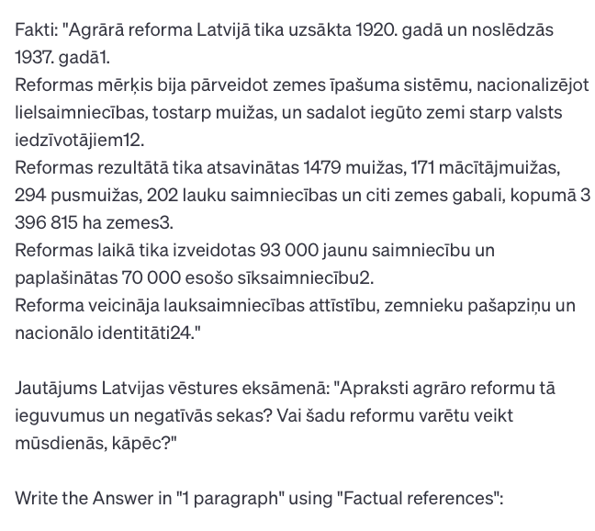
2. ChatGPT + Sources
* Valoda

Slide 18
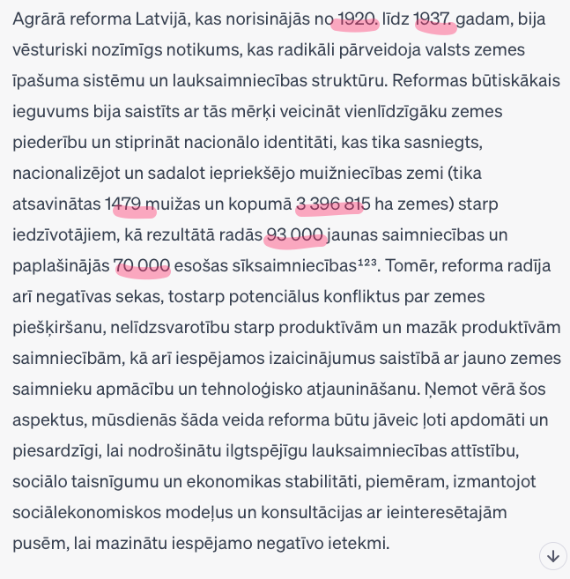
2. ChatGPT + Sources

Slide 19
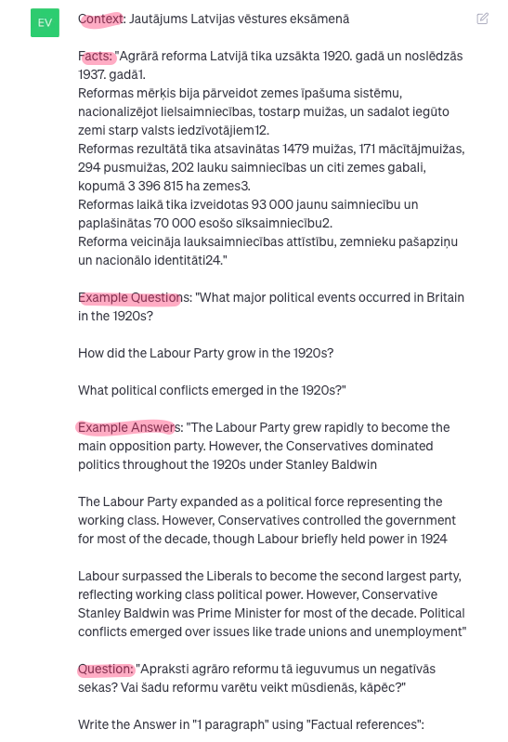
2. ChatGPT + Sources + Examples

Slide 20
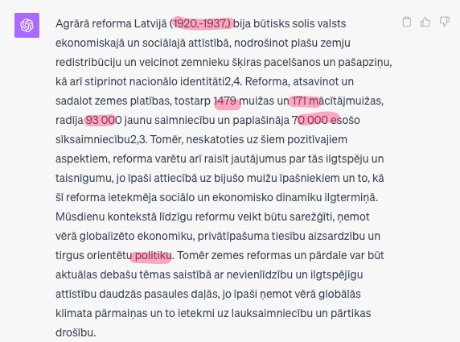
2. ChatGPT + Sources + Examples
* Valoda

Slide 21
Improvisation theatre

Slide 22
ChatGPT = Language transformation

Slide 23
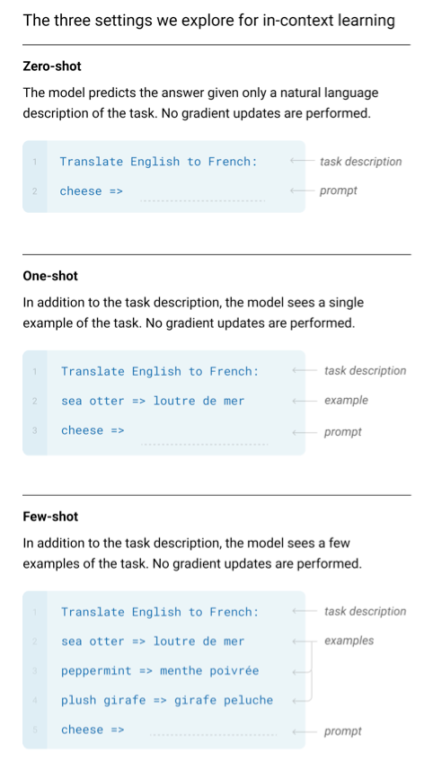
Language Models are Few-Shot Learners
2020 year, Fundamental publication, OpenAI

Slide 24
Prompt engineering "LEGO pieces"

Slide 25
Prompt engineering "LEGO pieces"
Search e
Search
Task
Context
Format
Facts
Examples
Persona
Tone
GPT4
Chain of
thought
Result

Slide 26
First words

Slide 27
Rules
Each series of prompts in a new session
Write tasks and keywords in English
Start the task section with a verb
Write terms and keywords with Capital Initial Letters
Separate multi-word facts, examples, "Keywords" with quotation marks
Correct grammar mistakes
Structure the query
Add as many Facts and Examples as possible (x10)
Output formatting
Be aware of Limitations (context length)

Slide 28
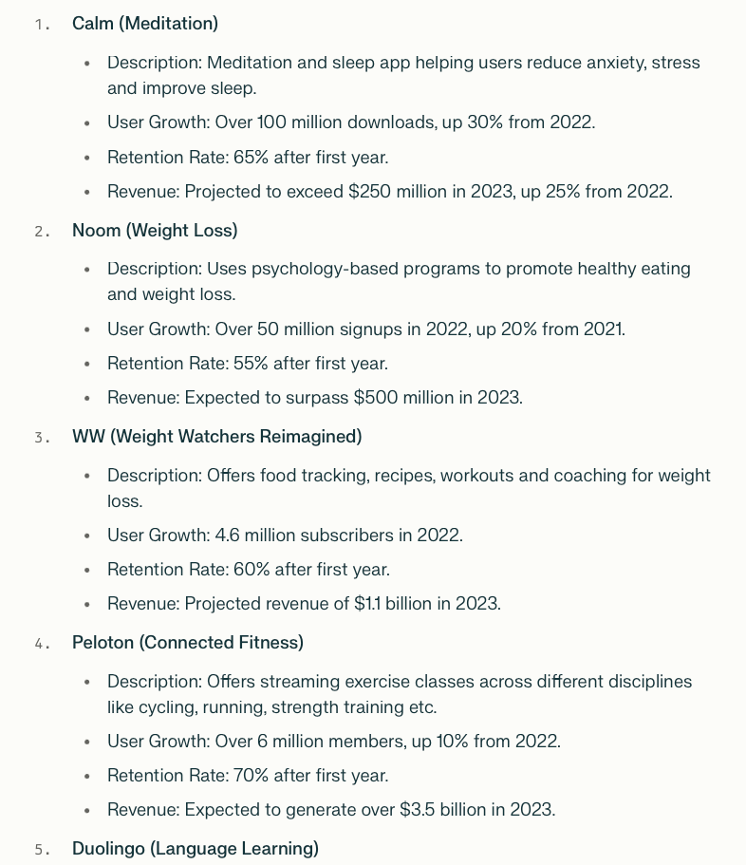
Facts

Slide 29
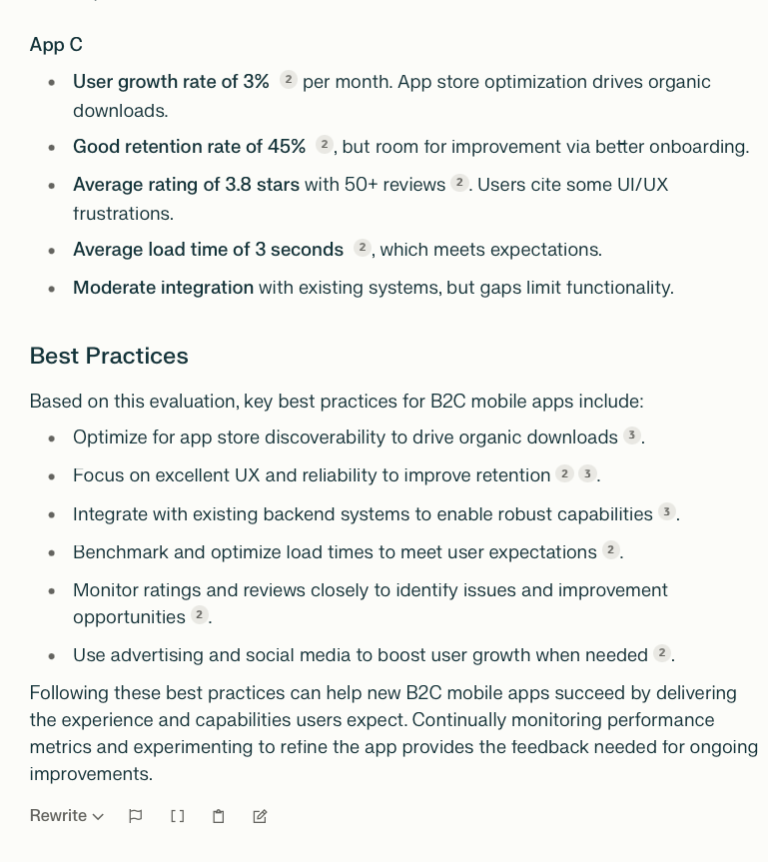
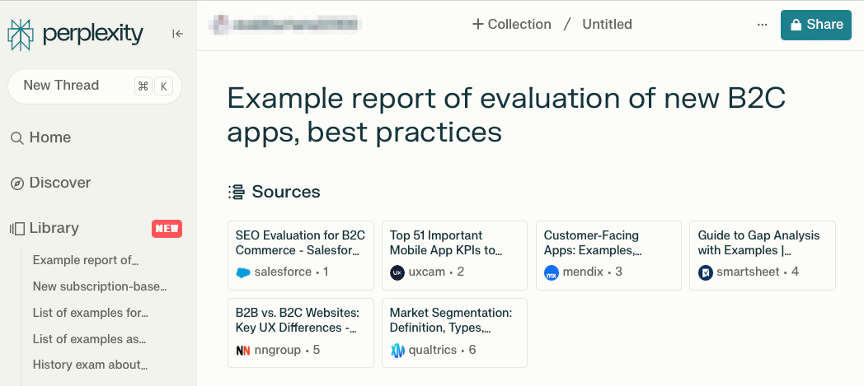
Examples (n-shot)

Slide 30
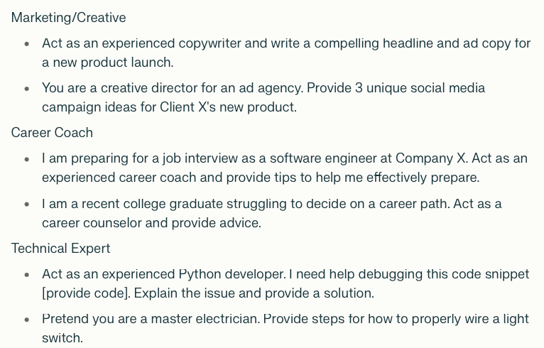
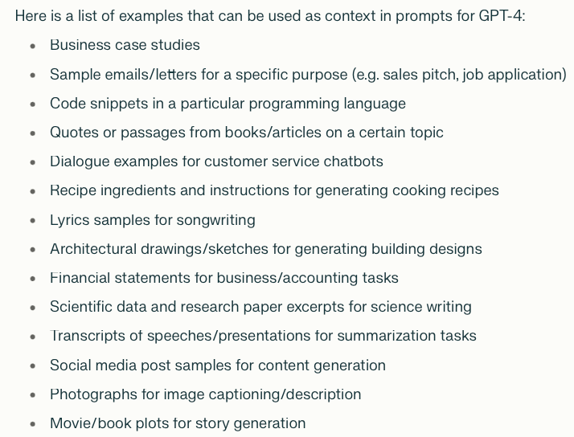
Context & persona
Bonus: Act as Steve Jobs in a Role as "Innovation Officer" at Apple preparing a Report to evaluate new product proposals.
character.ai

Slide 31
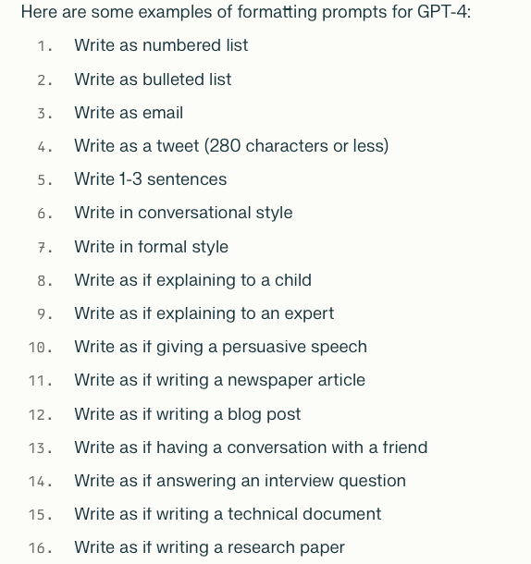
Output formatting
Markdown (alternative to Word)
Mark changes in the Answer in Bold.
Table, CSV, formalize as code, HTML, Question, Summary, Tweet
1-2 paragraphs

Slide 32
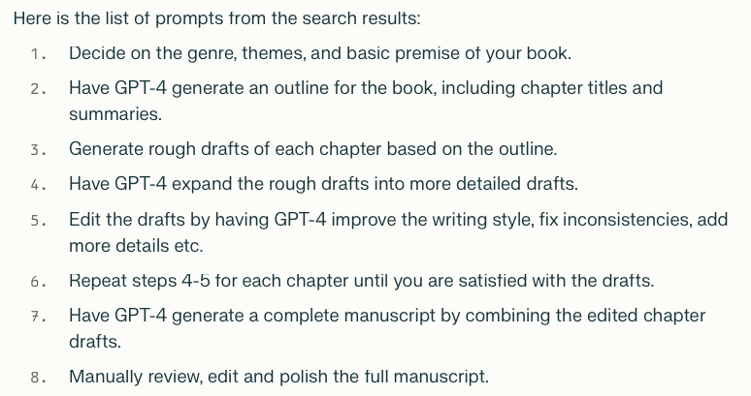
Writing Books

Slide 33
3. Fine tunning model
LLama, Mistral

Slide 34
3. RAG (Retrieval augmented generation)
Facts
Text embedding
ChatGPT
Fact
Knowledge base CRM, ERP,
e-mail, etc.
Prompt
Prompt
Response
Notes:
LangChain

