Slide 1
Helmes Next Generation
contact centre
solution

Slide 2
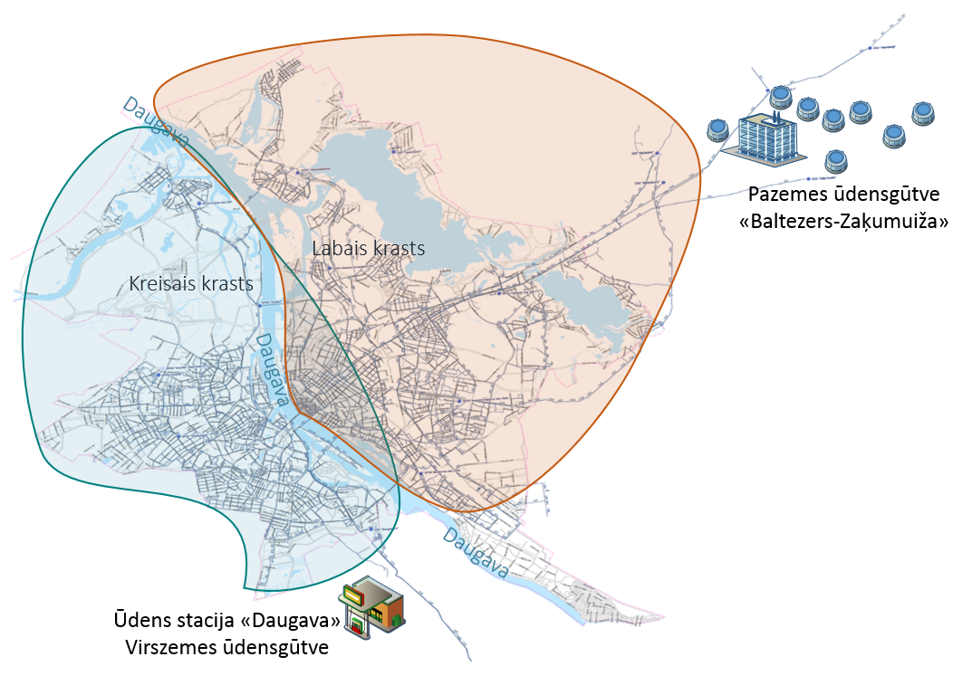
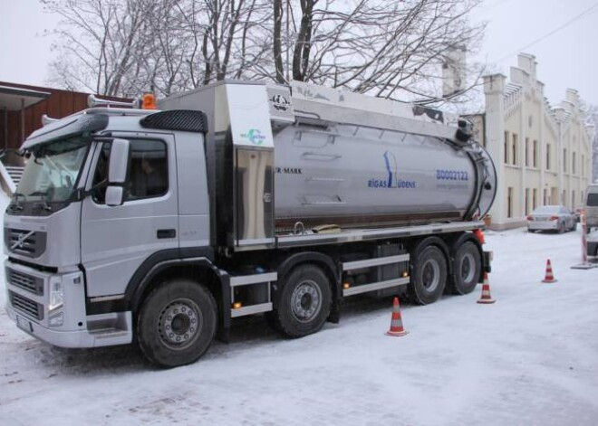
Case study from largest utility
company in Riga (Latvia) serving
more than 600k clients.
Company deployed "PitchPatterns" solution on-premises to automate
call quality control and
improve conversion rates
for connecting new
clients to the public water network. With "Eldigen" we are also automating
e-mail communication and
document validation.

Slide 3
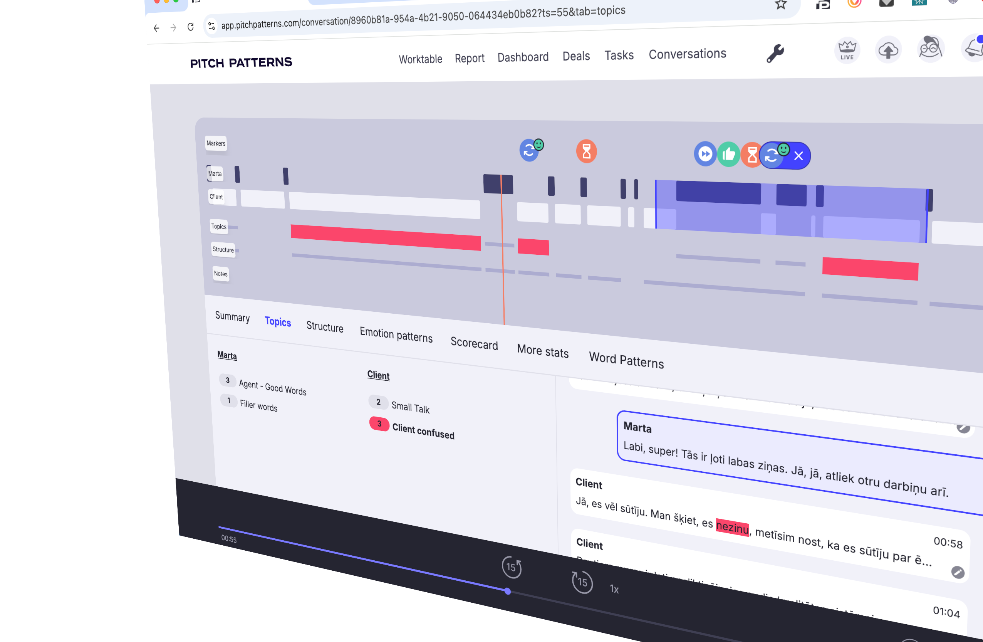
Call duration shortened
by at least 20%,
Improved quality of information obtained from calls,
reducing the number of dissatisfied clients
by at least 30%.
Automatically fills CRM after the call
Saves 40 hours/month on call time and quality control

Slide 4
The outgoing robocall solution to for debt collection, information dissemination, surveys.
Automatically detects the conversation topic statistics from a high-quality transcript in Latvian, Estonian, Lithuanian, Russian, English, and German languages (Baltic languages error CER 10%)
Replace a full-time call operator's job at up to 160 hours/month.

Slide 5
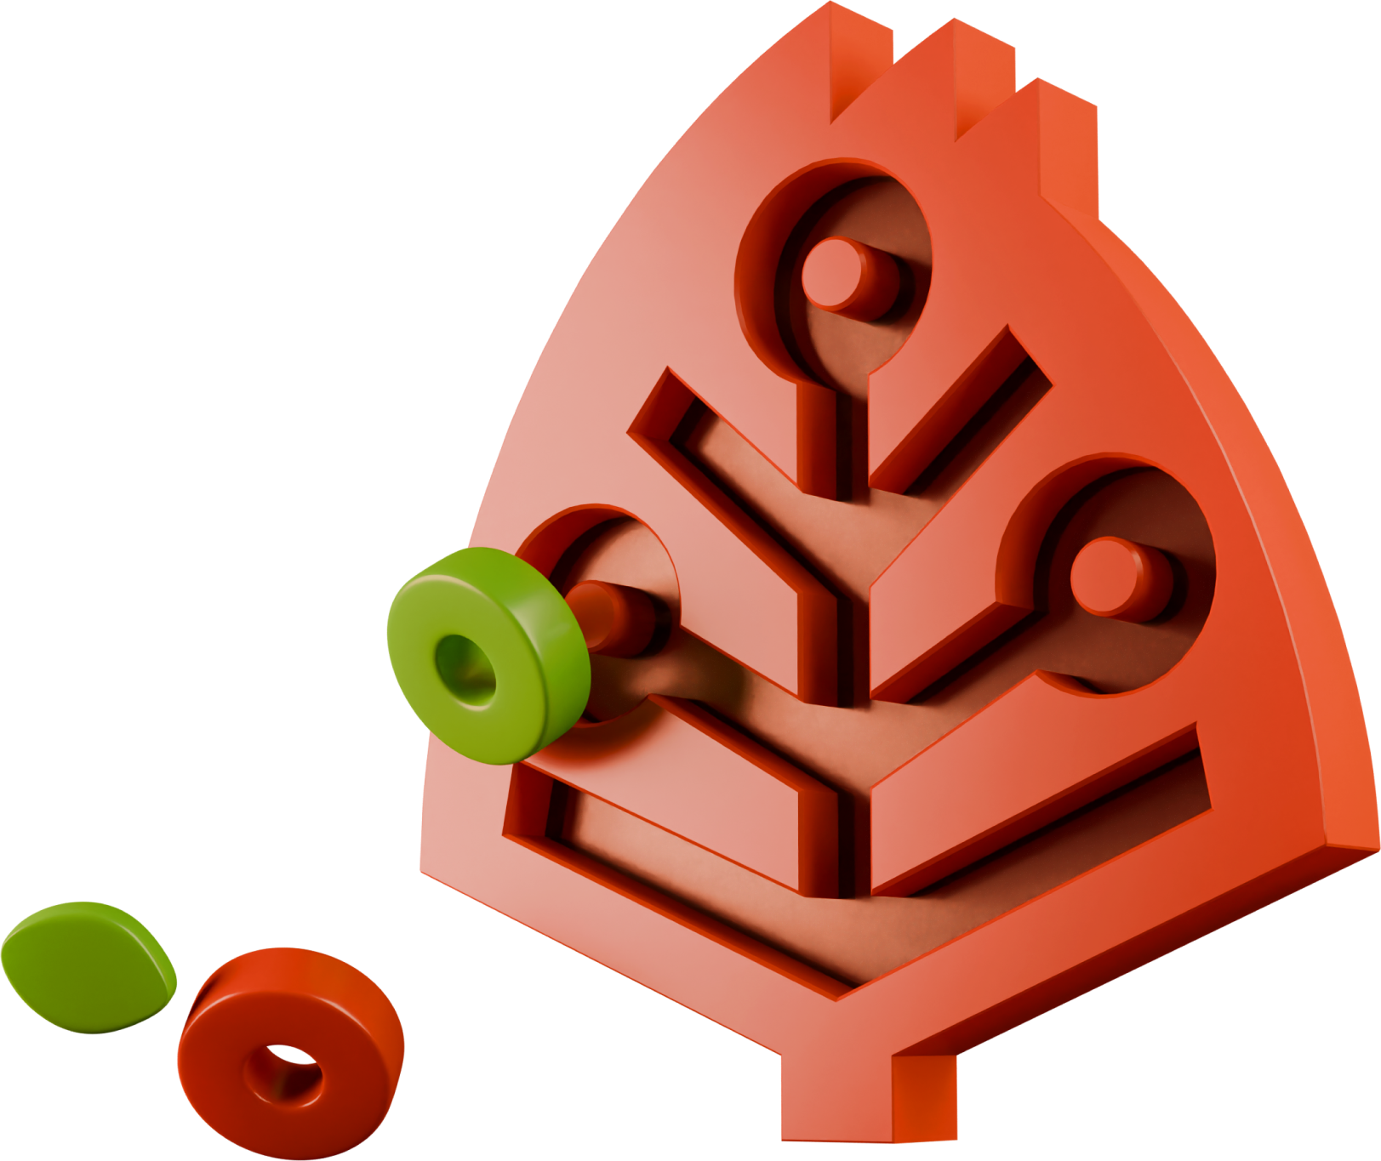
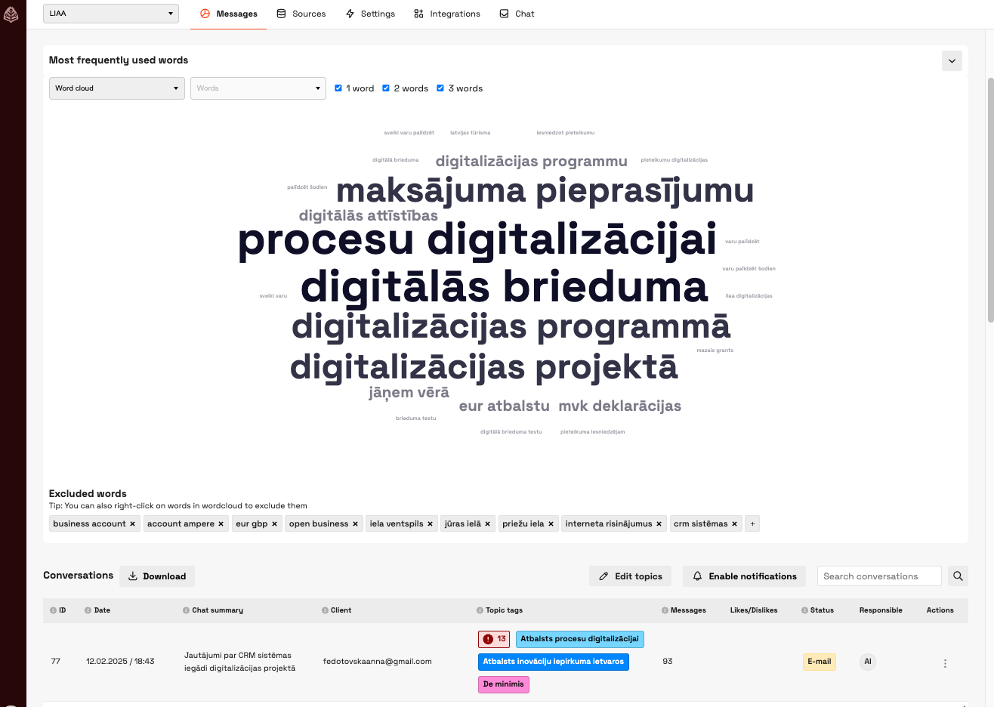
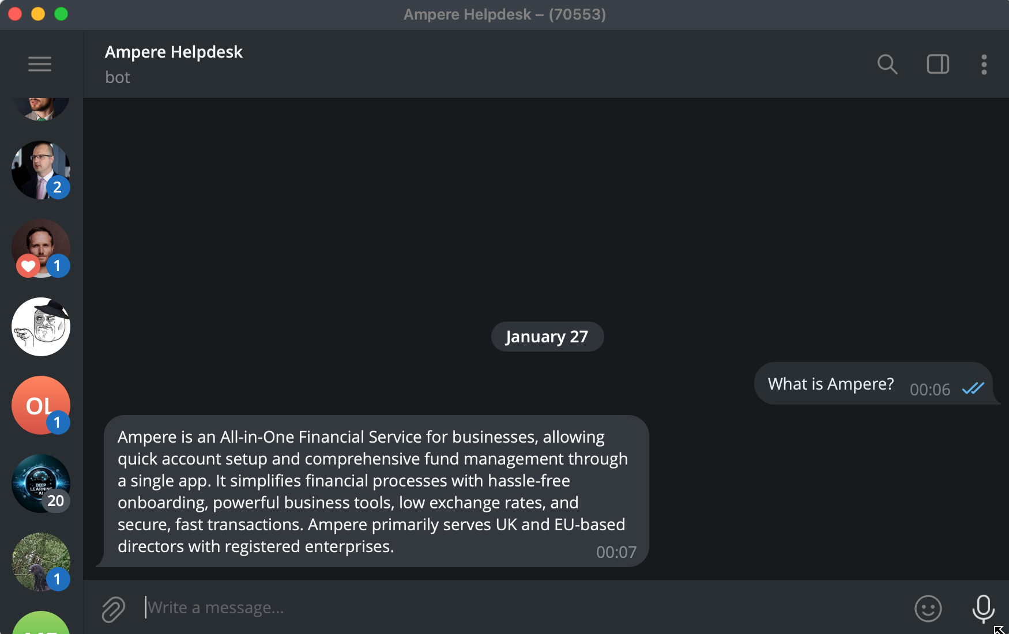
Omni-channel automated communication Email, Telegram, WhatsApp, custom integrations (Jira, Zendesk) Monthly 3000 messages, up to 30% automation and savings of 40 hours/month in administration and
customer service costs

Slide 6
Document validation system
Automate up to 50% of the work
in procurement, offers, HR documents.
Savings per process up to 40 hours/month.

Slide 7
Automated training and testing platform.
Automatically prepares training materials and assesses knowledge for standard training programs, such as workplace safety, customer service, etc.
Saves up to 20 hours/month on preparing one training session and evaluating an employee.

